Slide 1
Measurement of differential production cross section for high-pT top quarks in proton-proton collisions at 13 TeV
(l+jets & hadronic ttbar decay channels)
LHCtopWG
14 May 2020
Georgios Bakas on behalf of the CMS collaboration
TOP-18-013

Slide 2

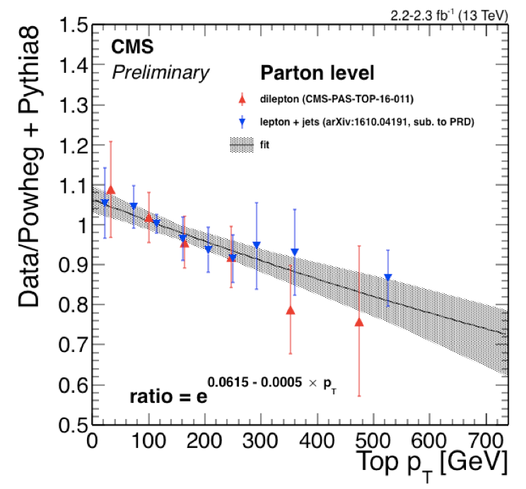

Towards accessing high pT with precision
Explore the kinematic region beyond the reach of the resolved analyses (pT > 400 GeV)
Possible to become precise
Sensitive to new physics
Crucial test for perturbative QCD
Two distinct final states
L + jets (boosted hadronically decaying top quark & resolved leptonically decaying top quark)
Hadronic (both boosted top quarks decaying hadronically)
boosted top decaying hadronically reconstructed as a large-radius jet
pT ~ 2Mt/R ~ 400 GeV

Slide 3
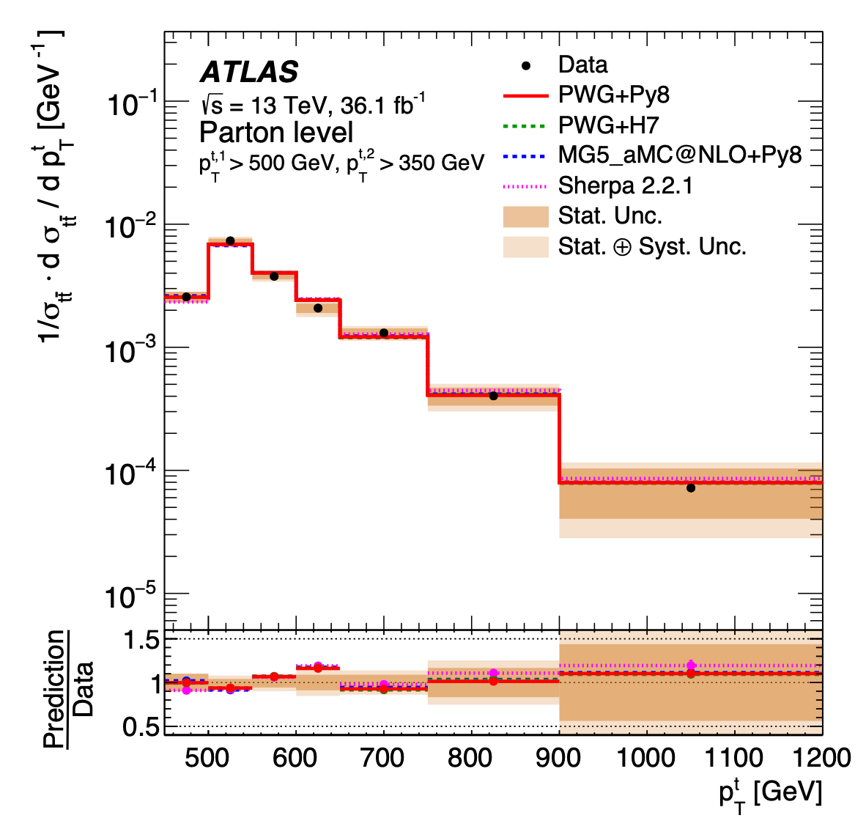
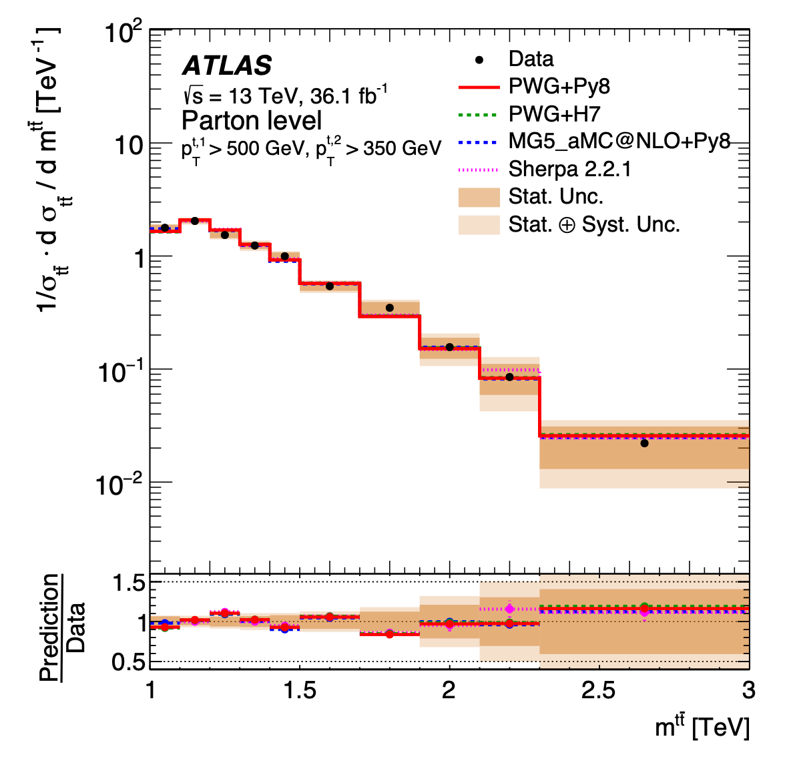
Towards accessing high pT with precision
ATLAS:
TOPQ-2016-09
$t\overline{t}$ pair to all-hadronic final states
13 TeV
2 large-R radius jets
Leading pT >500 GeV
Subleading pT > 350 GeV
Probes up to 1.2 TeV for leading jet pT
Probes up to 3 TeV for mttbar
CMS:
Probes up to 1.5 TeV for the leading jet pT
probes up to 4 TeV for mttbar
Compatible results regarding the inclusive cross section

Slide 4



Analysis Overview
2016 dataset
35.9 fb-1
Differential cross section:
Absolute
Normalized
2 final states: hadronic, l+jets
L + jets channel Deliverables:
Hadronically decaying top pT & |y|
Hadronic channel Deliverables:
Leading & subleading top pT & |y|
$t\overline{t}$ system mass, pT & rapidity
Unfold to Parton & Particle Levels

Slide 5
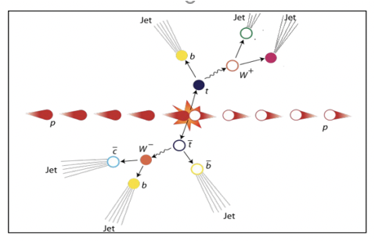
Analysis overview (hadronic)
Hadronic
Final State:
Two large R jets containing the decay products of top
Trigger:
Two AK8 (anti-kt, R=0.8) jets @ HLT and b tagging
Selection:
Two AK8 (anti-kt, R=0.8) jets with pT > 400 GeV,
“ttbar event tagging” NN using jet substructure variables as inputs
Categories based on subjet b tagging
0-btag: control
2-btag: signal
Backgrounds
QCD dominant: taken from data
Others (ST, W/Z+jets): negligible
Selection and $t\overline{t}$ reconstruction with NN
ML fit to the mass
of the leading jet
Signal Extraction
Unfolding

Slide 6
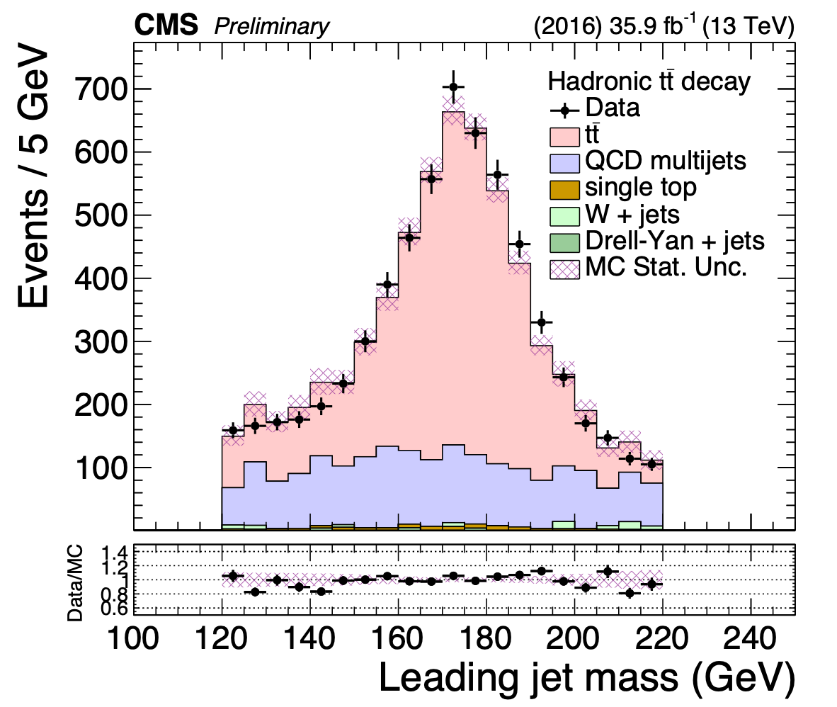
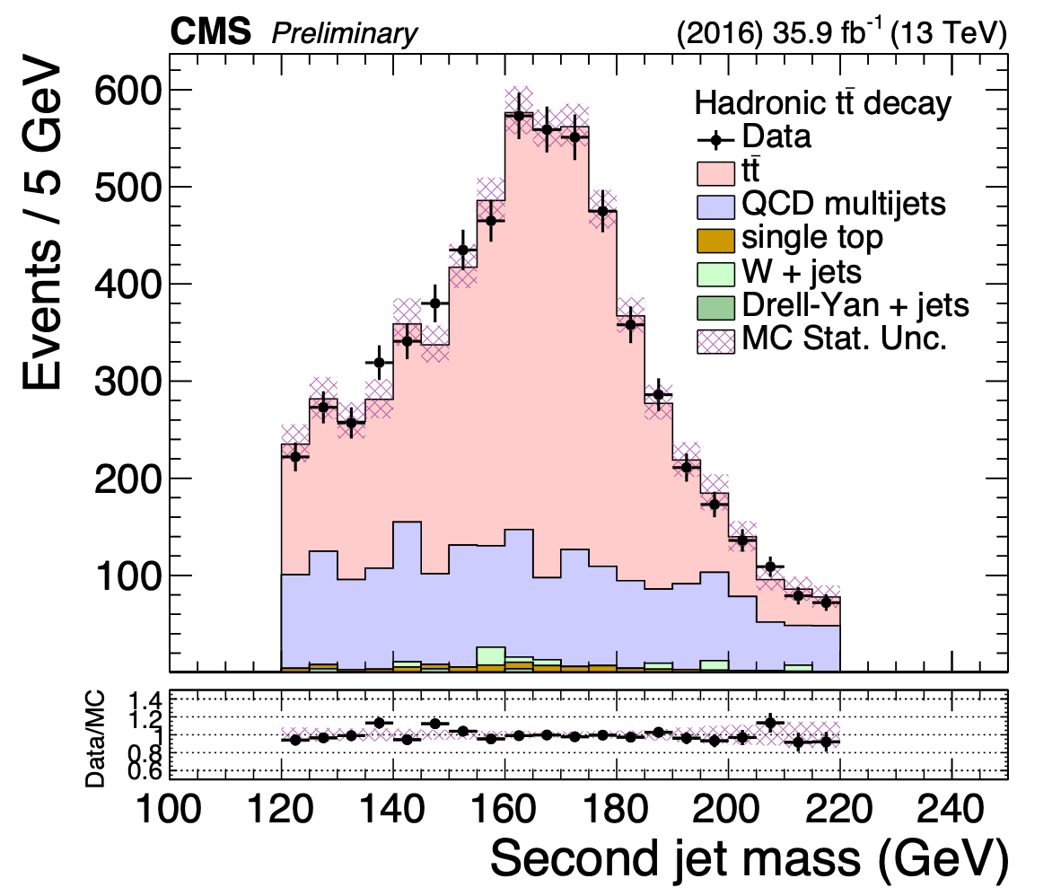
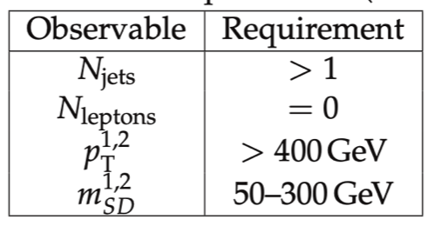

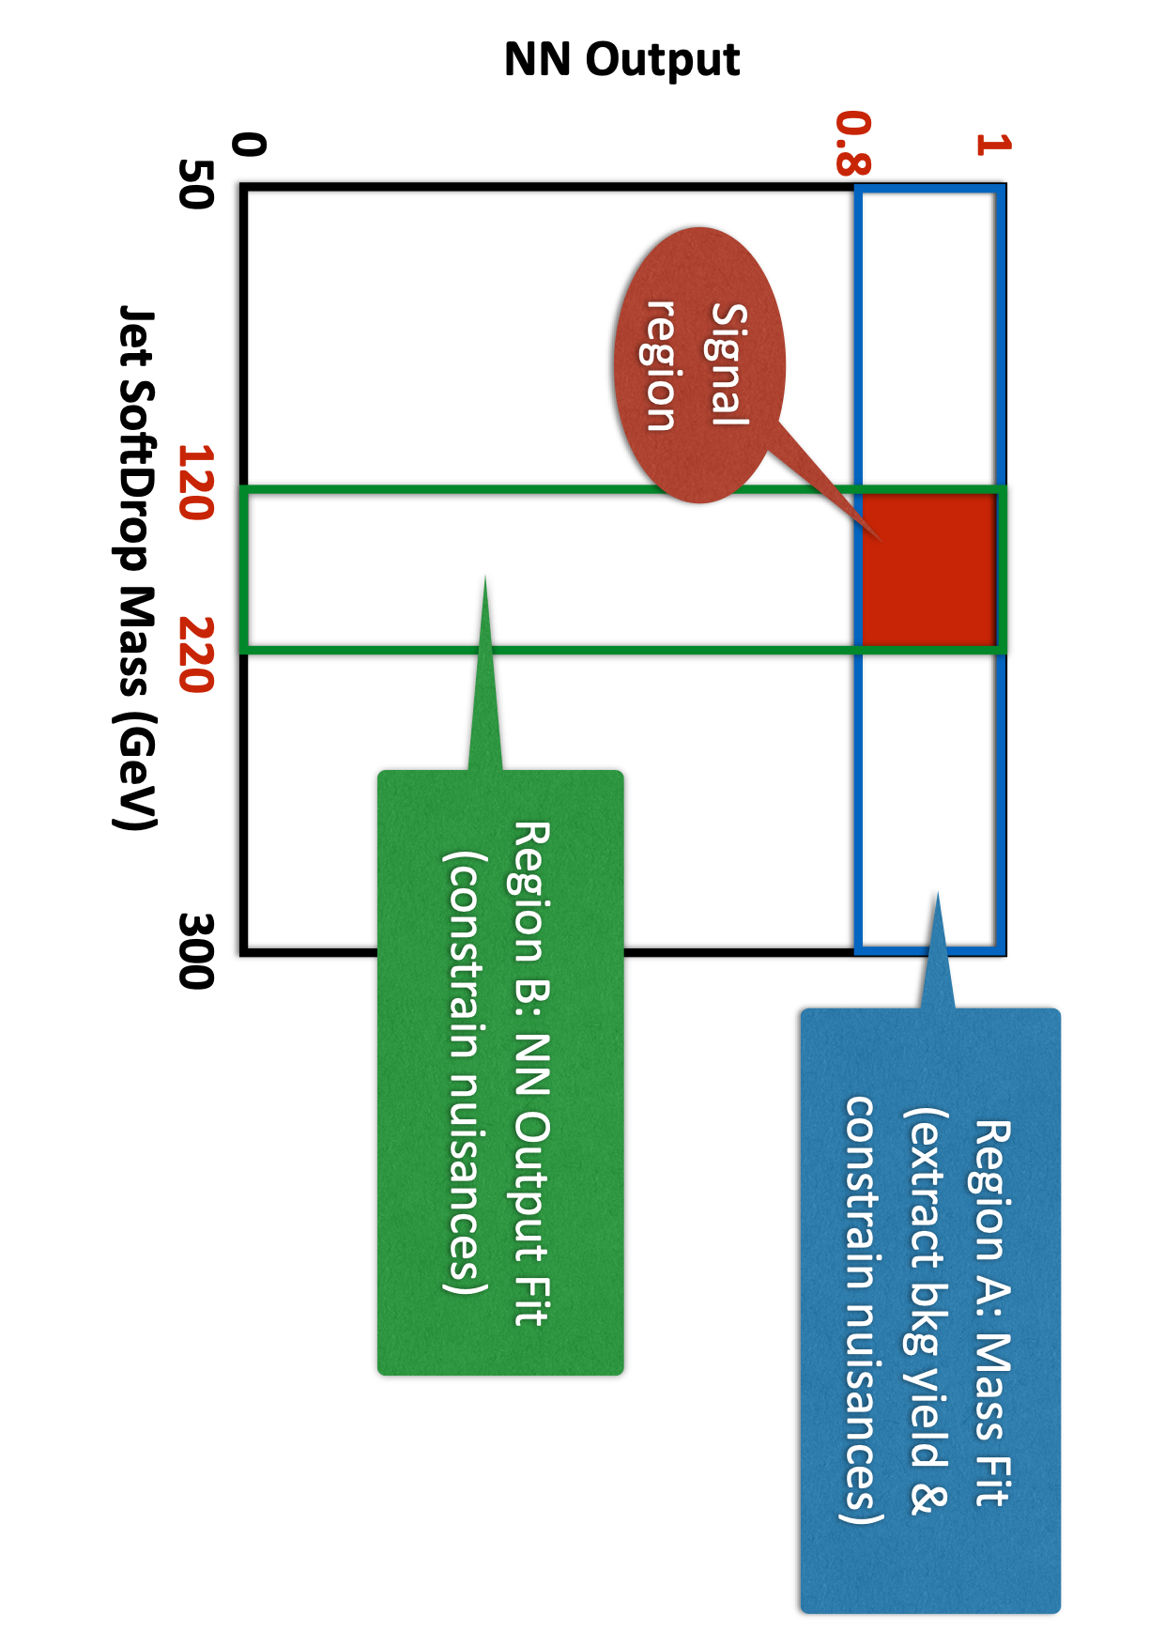
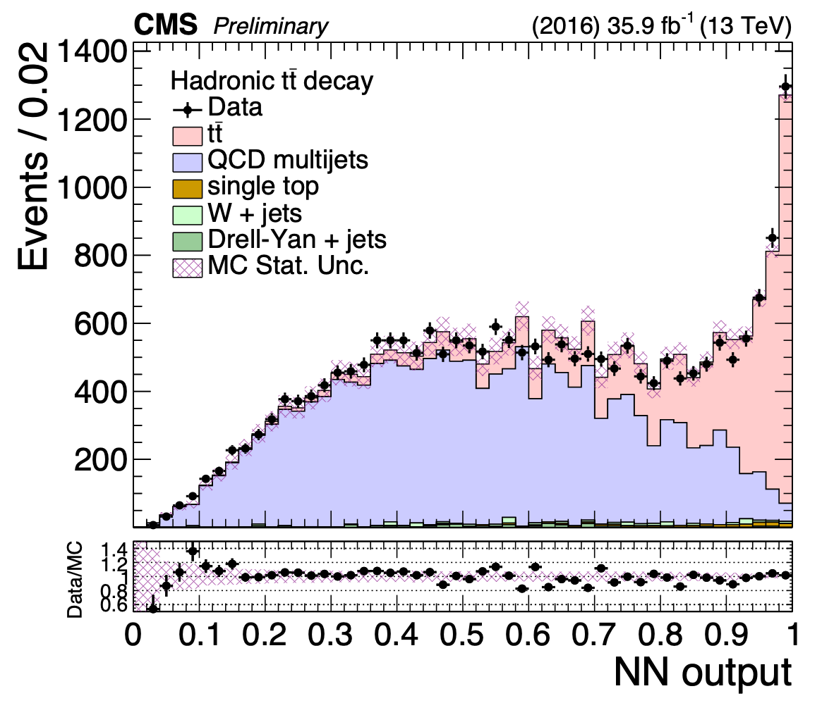
Selection & Analysis Regions (hadronic)
NN CUT (0.8)compromise between enough tt events and signal purity
b tagging Medium WP (2 subjets should be b tagged)
Control Region:
SR kinematics
invert the b tag requirement

Slide 7

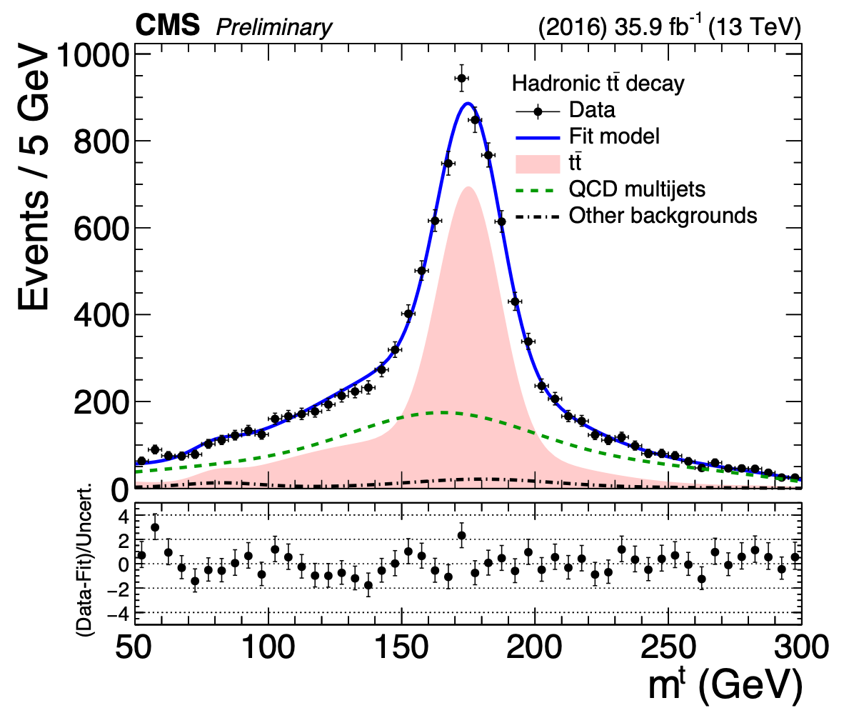
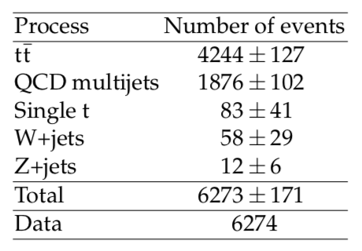
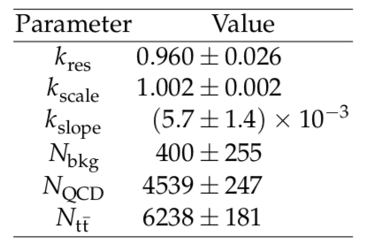

Signal Extraction (hadronic)
Transfer factor from SRA to SR (taken from CRA/CR)
fiducial yield
Bkg shape
(taken from CR in data)
Data
Bkg yield
(fit in region SRA)
Bkg shape correction
(taken from MC)
$t\overline{t}$ Signal Strength
rtt = 0.64

Slide 8
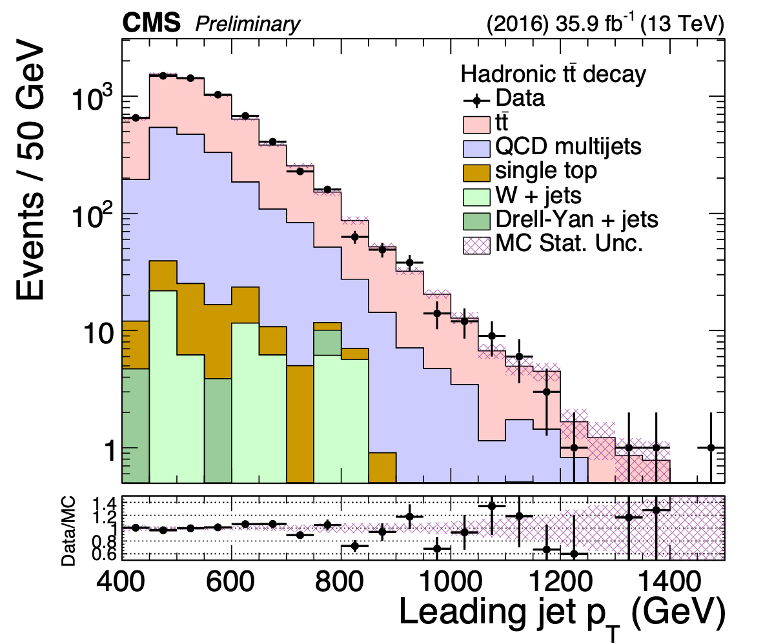
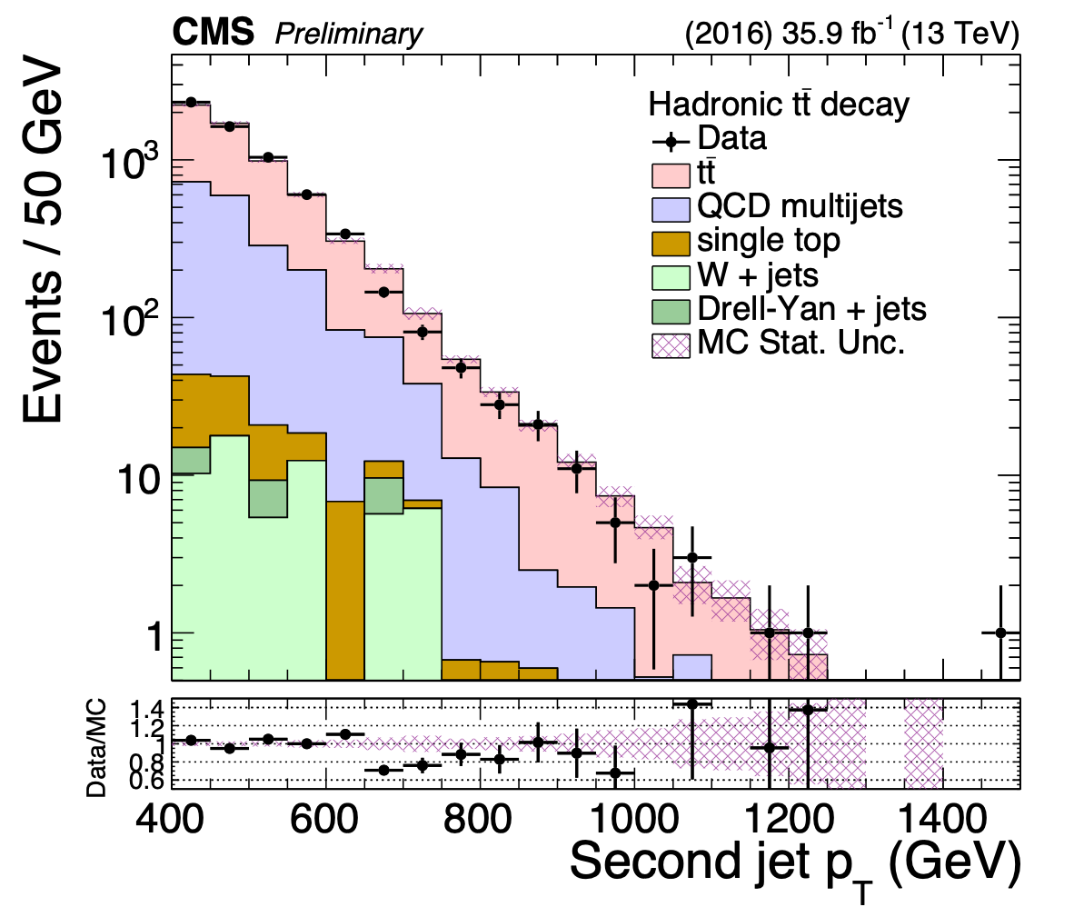
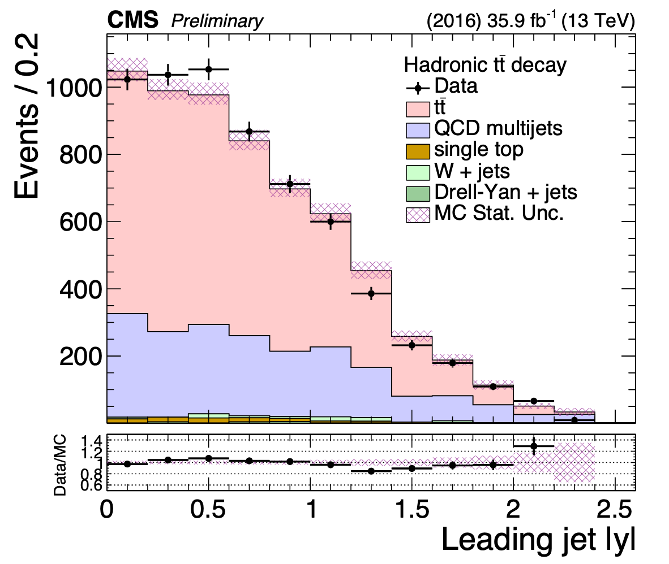
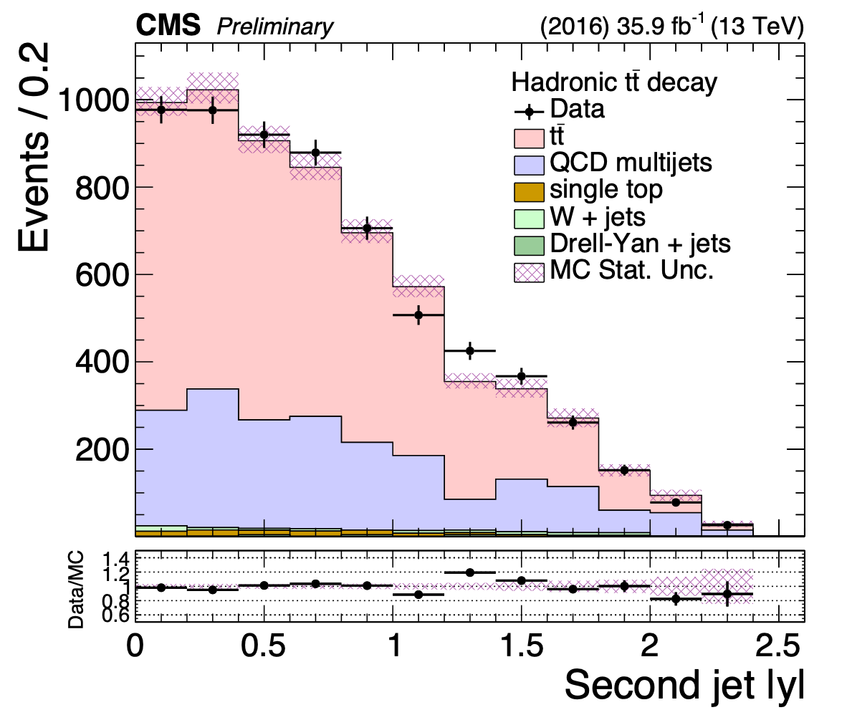
Top kinematic distributions (hadronic)

Slide 9
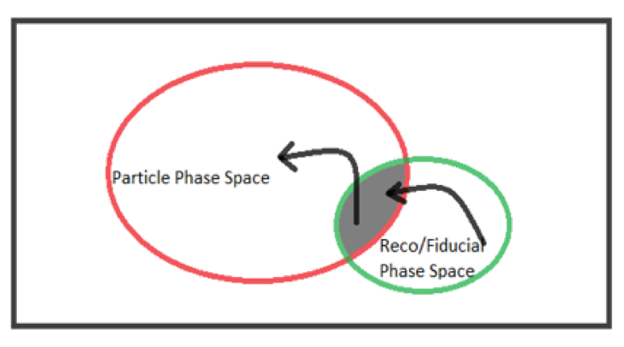
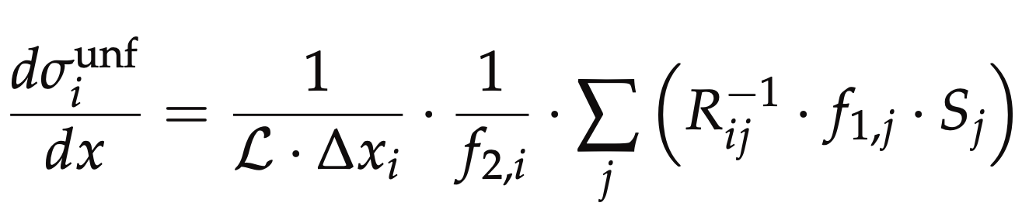
Parton & Particle levels (hadronic)
Particle
top candidates: AK8 genjets
Parton
Observable | Requirement
Njets | > 1
pT^{jet1, 2} | > 400 GeV
|η^{jet1, 2}| | <2.4
mSD^{jet1,2} | (120,220)GeV
mttbar | > 800 GeV
Observable | Requirement
pT^{t, tbar} | > 400 GeV
|η^{t,tbar}| | <2.4
mttbar | > 800 GeV
efficiency of the reco+true selection
migration matrix
reco efficiency of the reco+true selection
Unfolding: simple response matrix inversion w/o regularisation

Slide 10
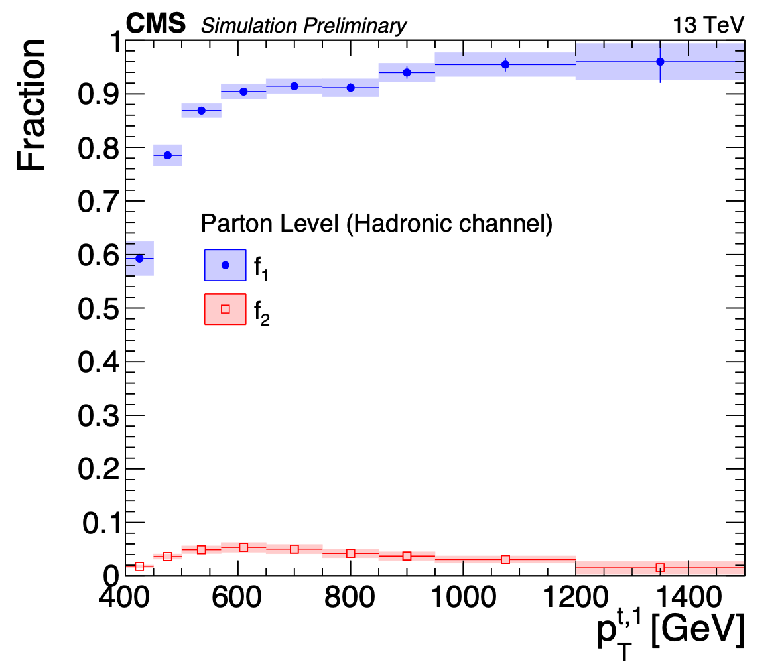
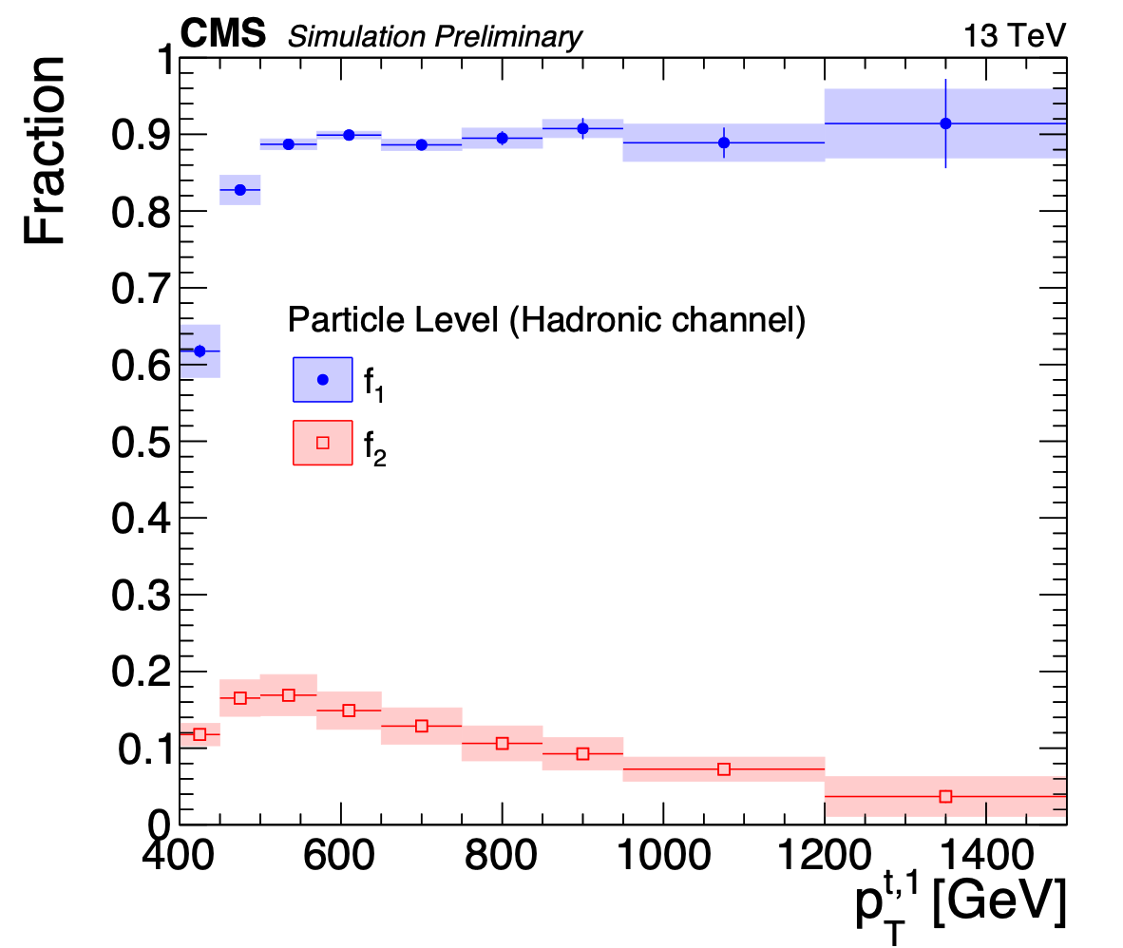


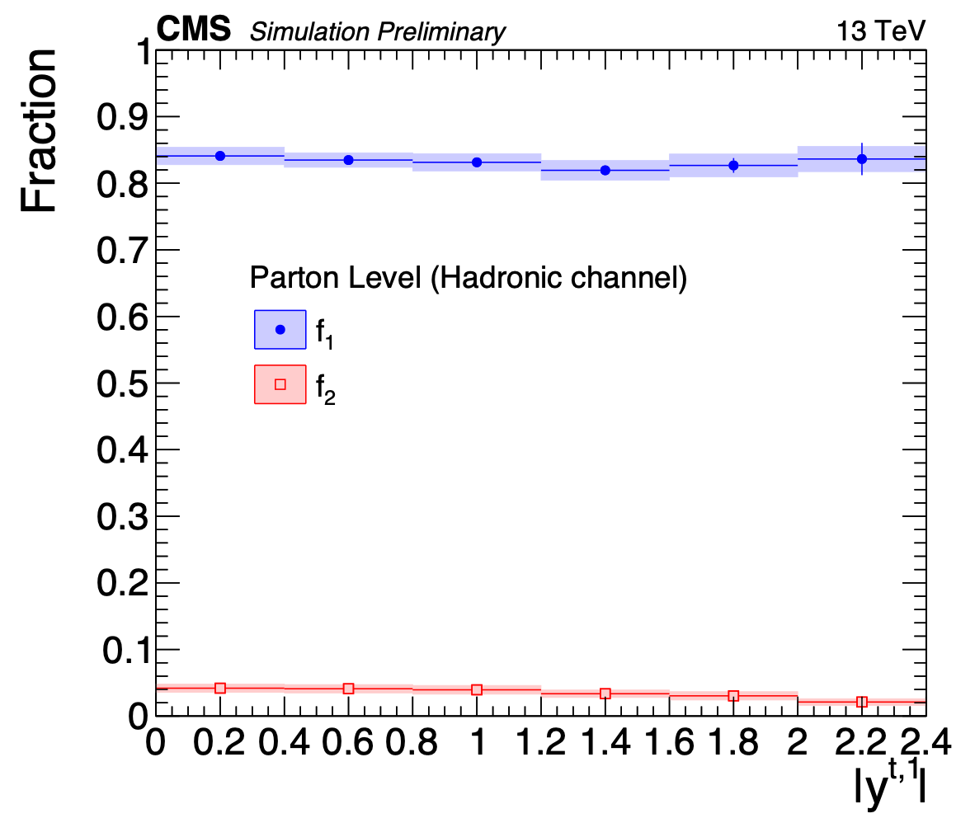
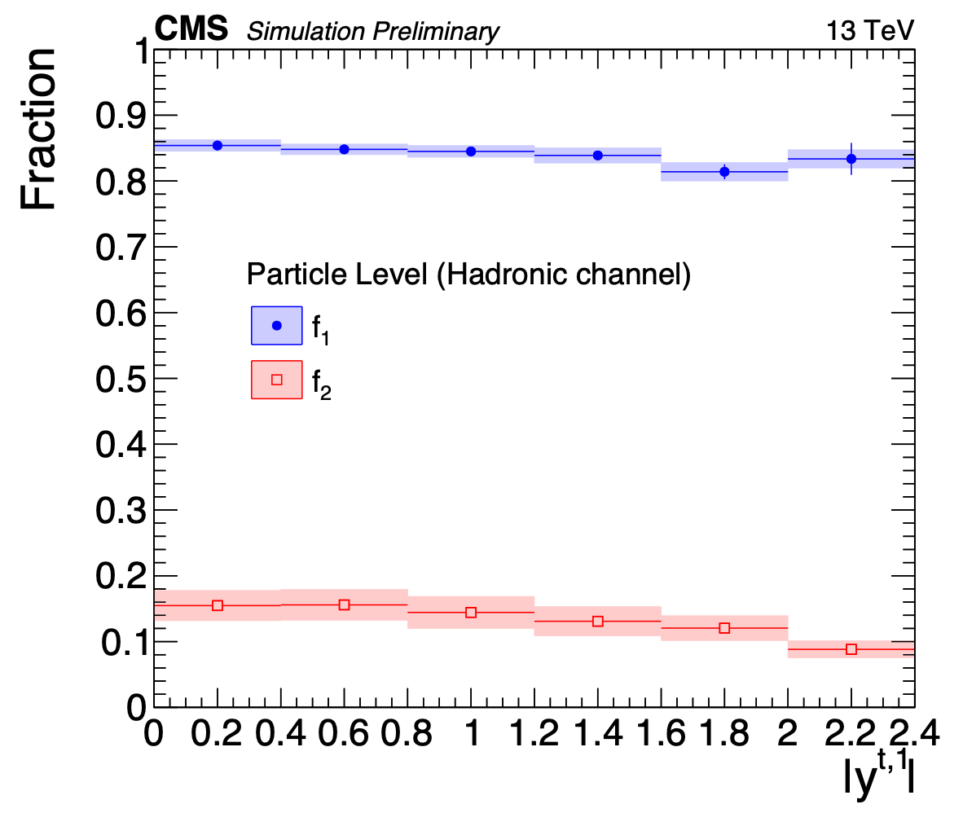
Fractions of parton & particle level definitions
f1: fraction of reco events in the reco+parton/particle phase space
f2: fraction of parton/particle events in the reco+parton/particle phase space

Slide 11
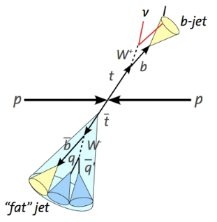
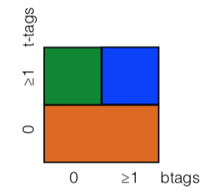
Analysis Overview (l+jets)
Final State:
Lepton + b jet + MET + t jet
Trigger:
Single Lepton: e (μ)
Two small-R jets
Selection:
==1 e/μ (veto additional leptons)
≥1 small-R jet (anti-kt, R=0.4, leptonic top decay)
≥1 large-R jet (anti-kt, R=0.8, hadronic top decay)
$$E_{T}^{Miss}$$
Characterise events by whether b and t jet candidate pass tagging requirements
b tagging:
AK4 jet
Medium b-tag WP
t tagging:
AK8 jet
105 < mtop candidate < 220 GeV
N-subjetiness ratio τ32 < 0.81 (Loose WP)
No b-tagging to improve signal acceptance
Categories:
0t: t-jet candidate fails to pass the top tagging requirements
1t0b: t-jet candidate passes the top tagging requirements but b-jet candidate fails the b tagging requirements
1t1b: both t-jet and b-jet candidates pass the respective tagging requirements
{
0t: AK4 jet η
Selection based on t-, b-jet categories
Simultaneous Binned ML fit
1t0b: AK4 jet η
Signal Extraction (1t1b category)
Unfolding
1t1b: AK8 jet mass

Slide 12

Background Estimation (l+jets)
Several sources of background:
Non-signal ttbar, single top quark, W+jets, Z+jets, diboson, QCD
All except QCD are modelled using MC
QCD: data driven technique
QCD:
Data in a sideband dominated by QCD:
-invert the requirement on the lepton: exactly one with 0.1 < miniIso < 0.2; Medium e ID
Subtract expected non-QCD contributions
Compare QCD shape in data sideband against QCD MC in data sideband signal region
Good agreement
Largest deviations in e pT and η
Simultaneous Likelihood Fit
$t\overline{t}$ signal strength, t tagging efficiency SF and bkg normalisations determined using simultaneous Binned Likelihood fit
Event categories fitted simultaneously:
0t: Background dominated
1t0b
1t1b: Signal Dominated
Systematics, normalisations enter as nuisances
e/μ + jets channels are fitted simultaneously
}
}
Best signal/background discrimination
QCD well modelled
AK4 jet η
}
AK8 jet SD mass

Slide 13
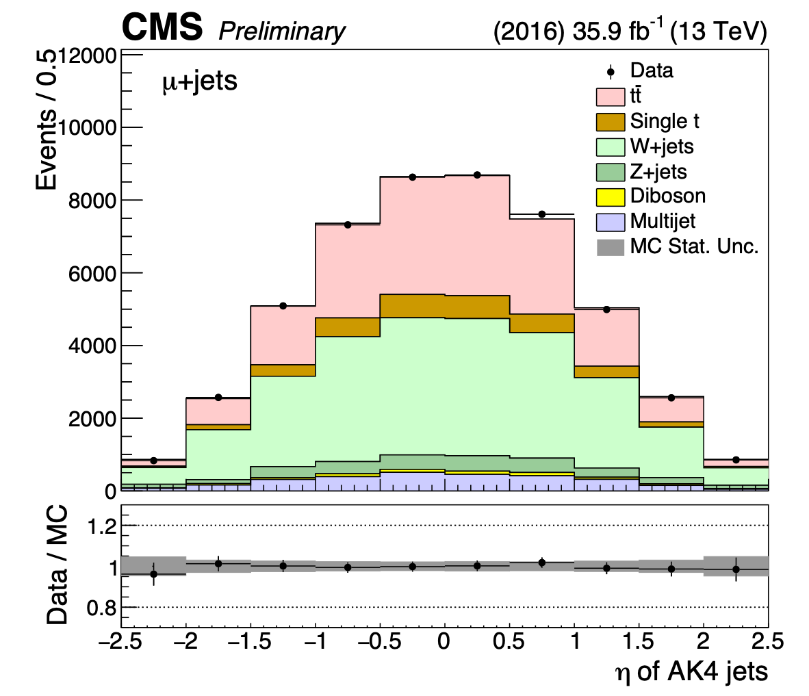
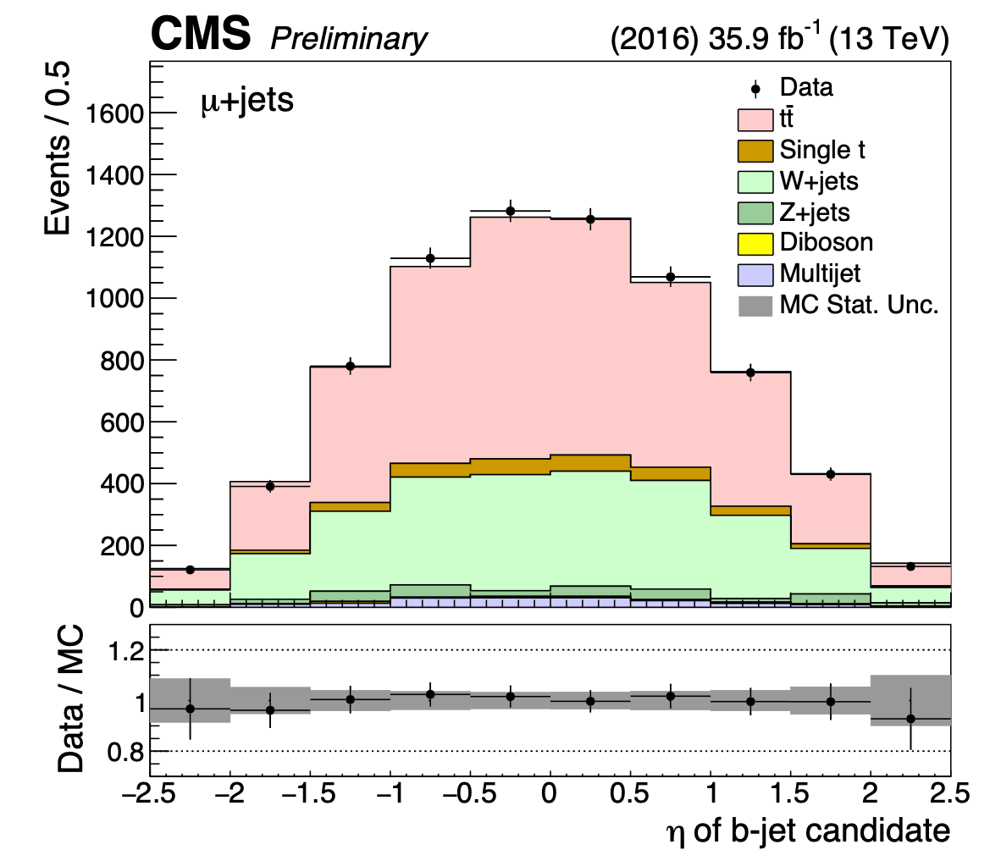
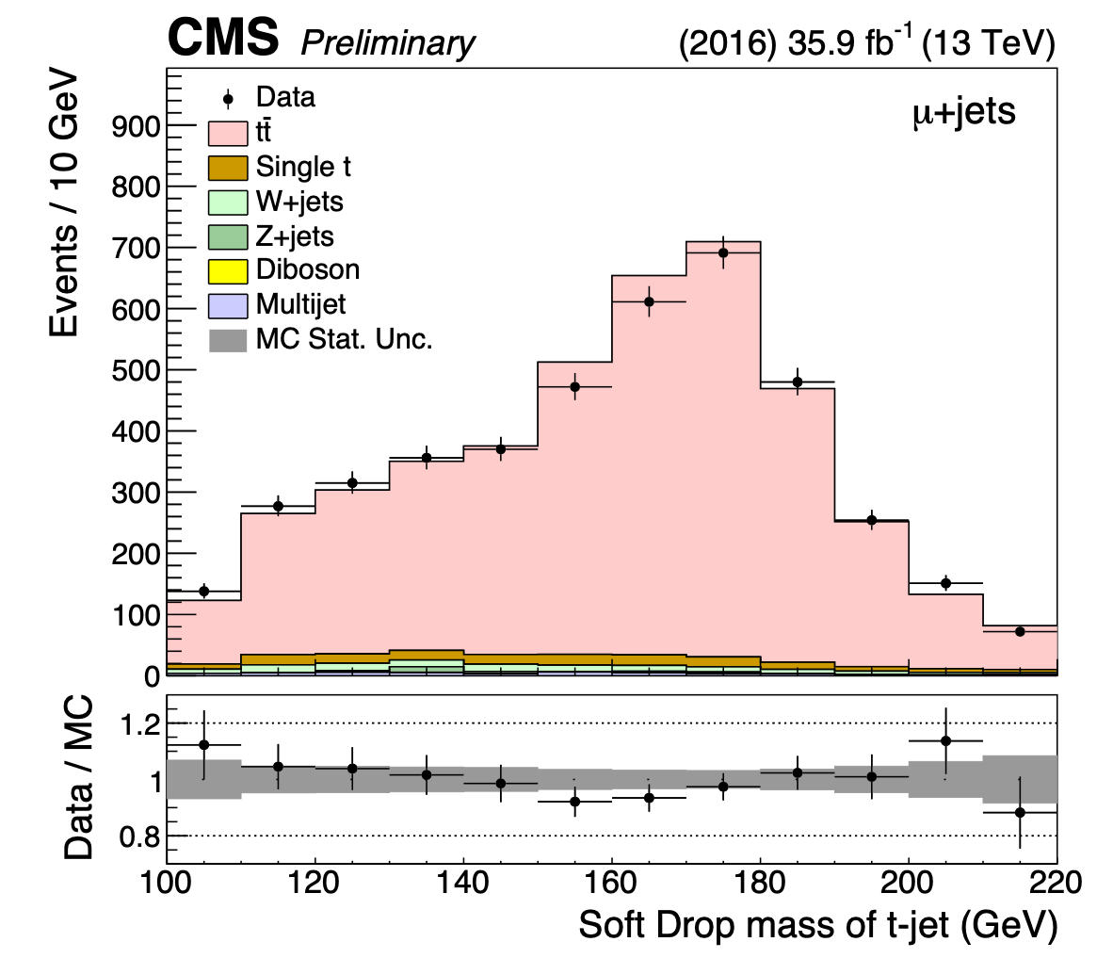
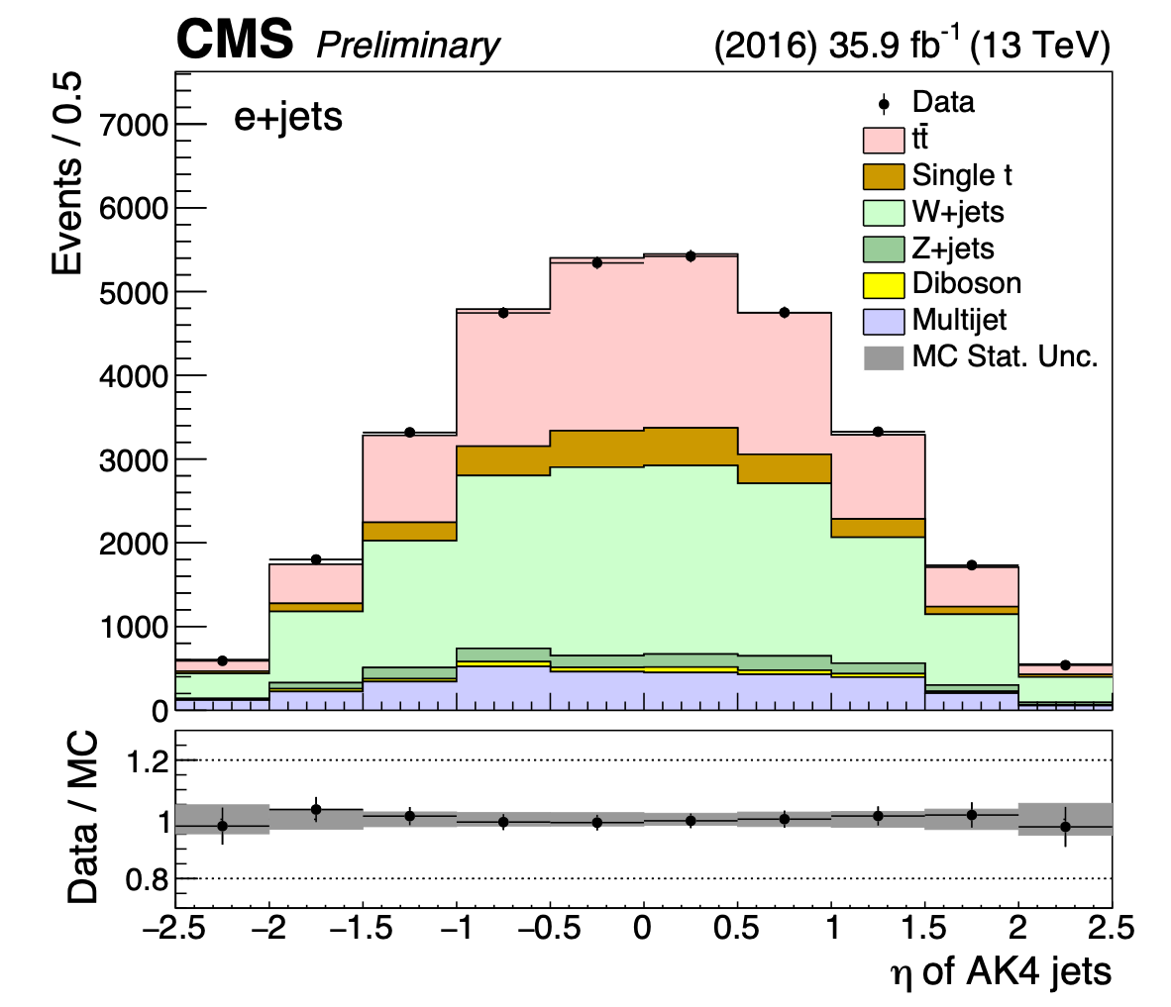
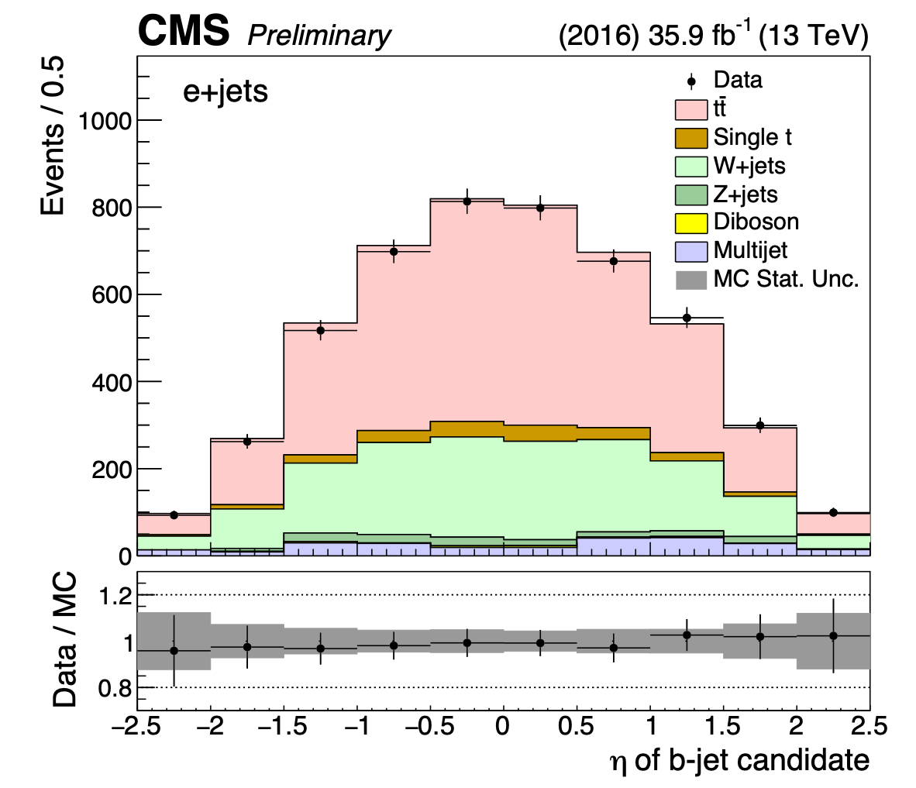
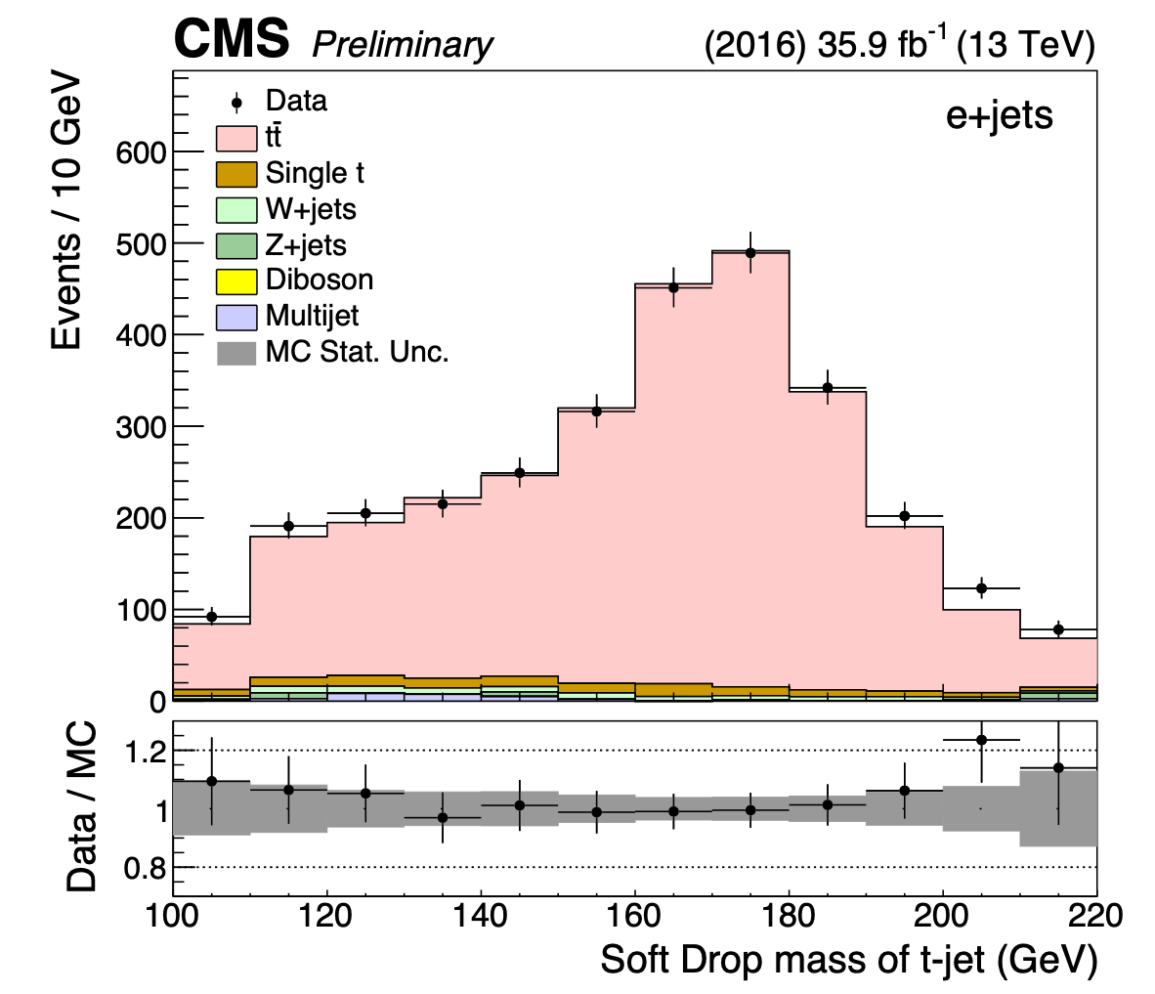
Post fit kinematic distributions (l+jets)
AK4 jet η, 0t
AK4 jet η, 1t0b
AK8 jet softDrop Mass, 1t1b

Slide 14
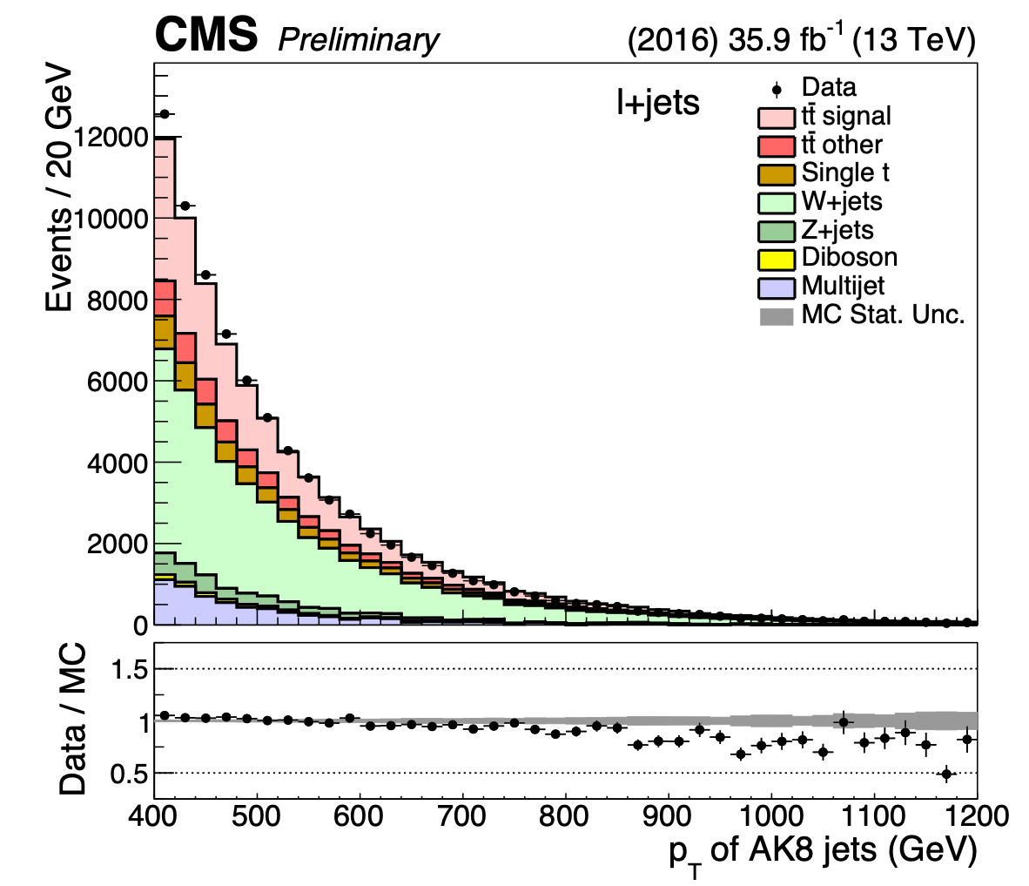
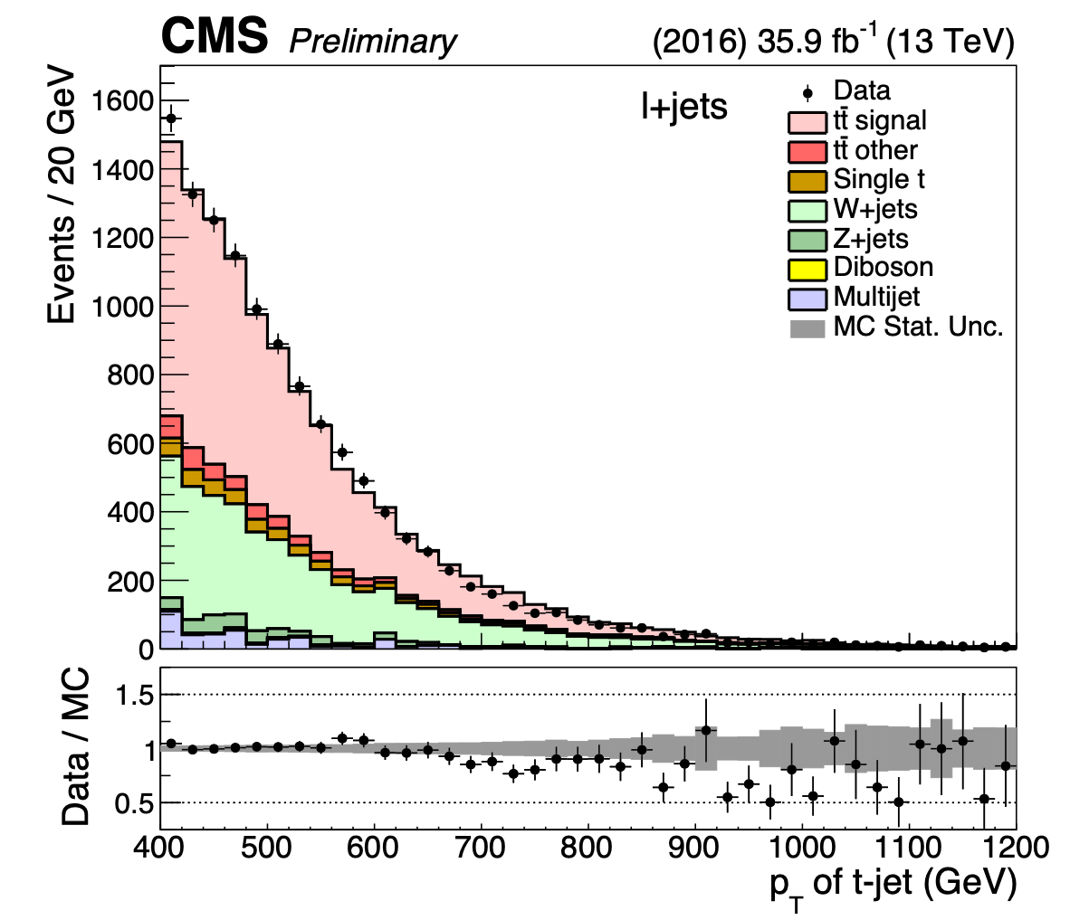
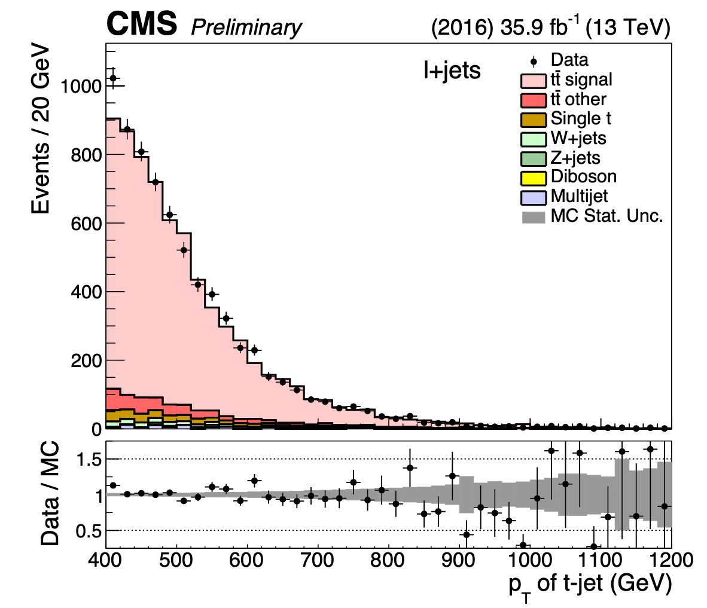
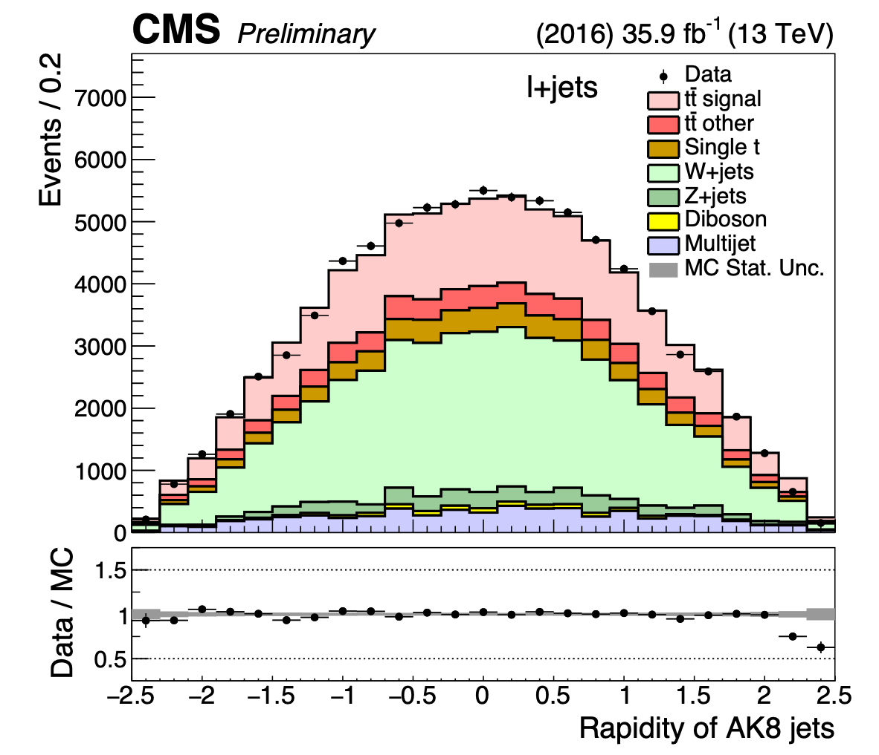
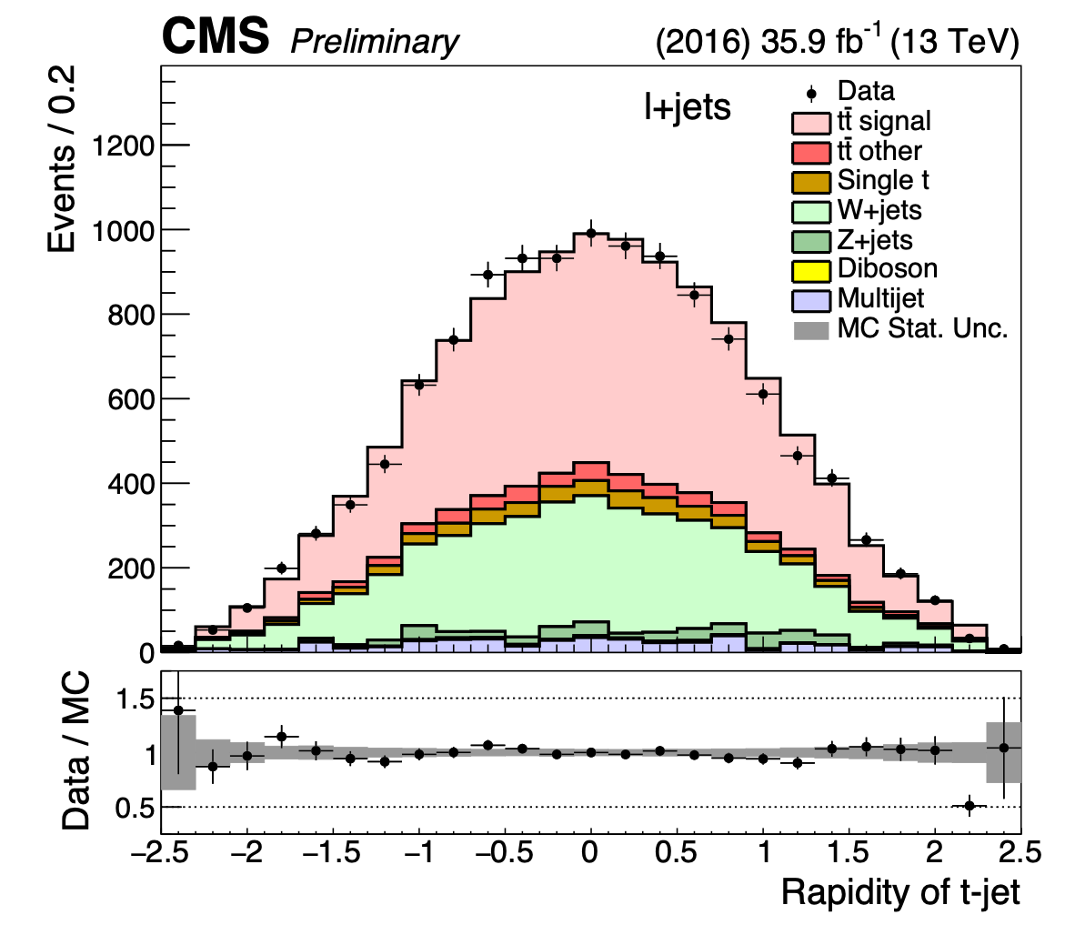
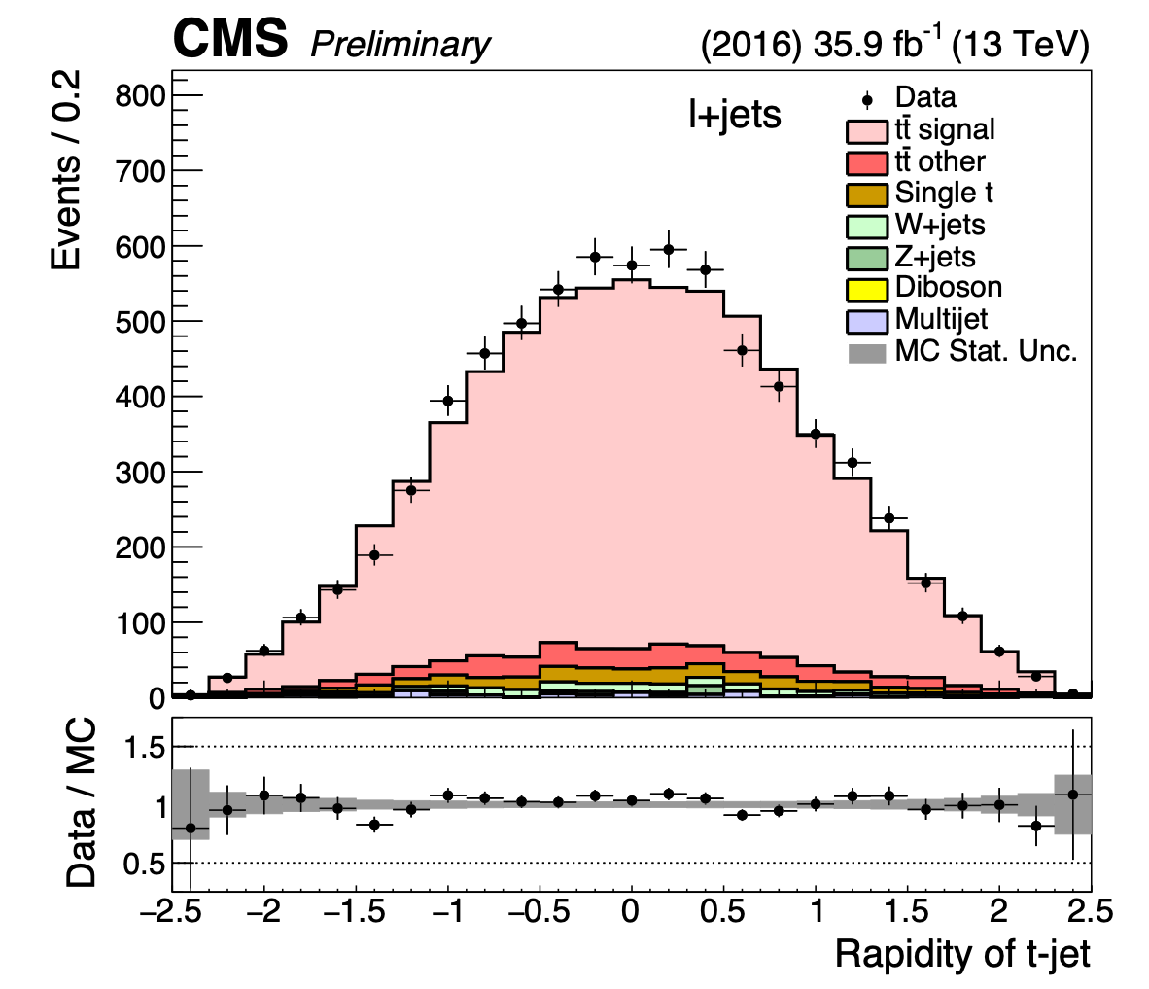
Post fit kinematic distributions (l+jets)
0t
1t0b
1t1b

Slide 15
Parton & Particle levels (l+jets)
Parton
Particle
Selection:
Confined to semi-leptonic ttbar with pT >400GeV for the hadronically decaying top quark
==1 μ/e
Top Quark: sign opposite of the lepton
Selection:
≥1 particle level AK8 jet:
pT > 400GeV
|η| < 2.4
105 < mjet < 220 GeV
≥1 particle level AK4 jet:
pT > 50 GeV
|η| < 2.4
Originating from b quark
==1 μ/e:
pT > 50GeV
|η|< 2.1
Top jet: leading particle level AK8 jet
Unfolding
Unfold pT(top), |y| (top) distributions to give cross section at Particle and Parton level of the hadronically decaying top quark
-Measured distribution: background-subtracted data in 1t1b signal region
Unfolding is performed with TUnfold
Simple matrix inversion
Without regularisation

Slide 16
Systematic uncertainties
Two categories:
Experimental: object performance between data and simulation
Theoretical: related to the simulation itself(acceptance, efficiency, migration matrix)
Experimental
Jet Energy Scale
Jet Energy Resolution
Pileup
Luminosity
Hadronic
QCD multijet Production
Subdominant Bkgs
Subjet b-tagging efficiency
Trigger
L + jets
Background estimate
t-tagging efficiency
b-tagging efficiency
Lepton Identification and Trigger
Theoretical: Divided into 2 groups
Matrix element of the hard process (variations of LHE event weights stored in nominal MC)
Modelling of the parton shower and the underlying event (dedicated, alternative MC samples)
Parton Distribution Functions
Renormalisation and factorisation scales:
Strong coupling constant
Final State Radiation (FSR): in situ constrained (hadronic)
Initial State Radiation (ISR)
Matrix Element-Parton showering matching
Underlying event tune

Slide 17
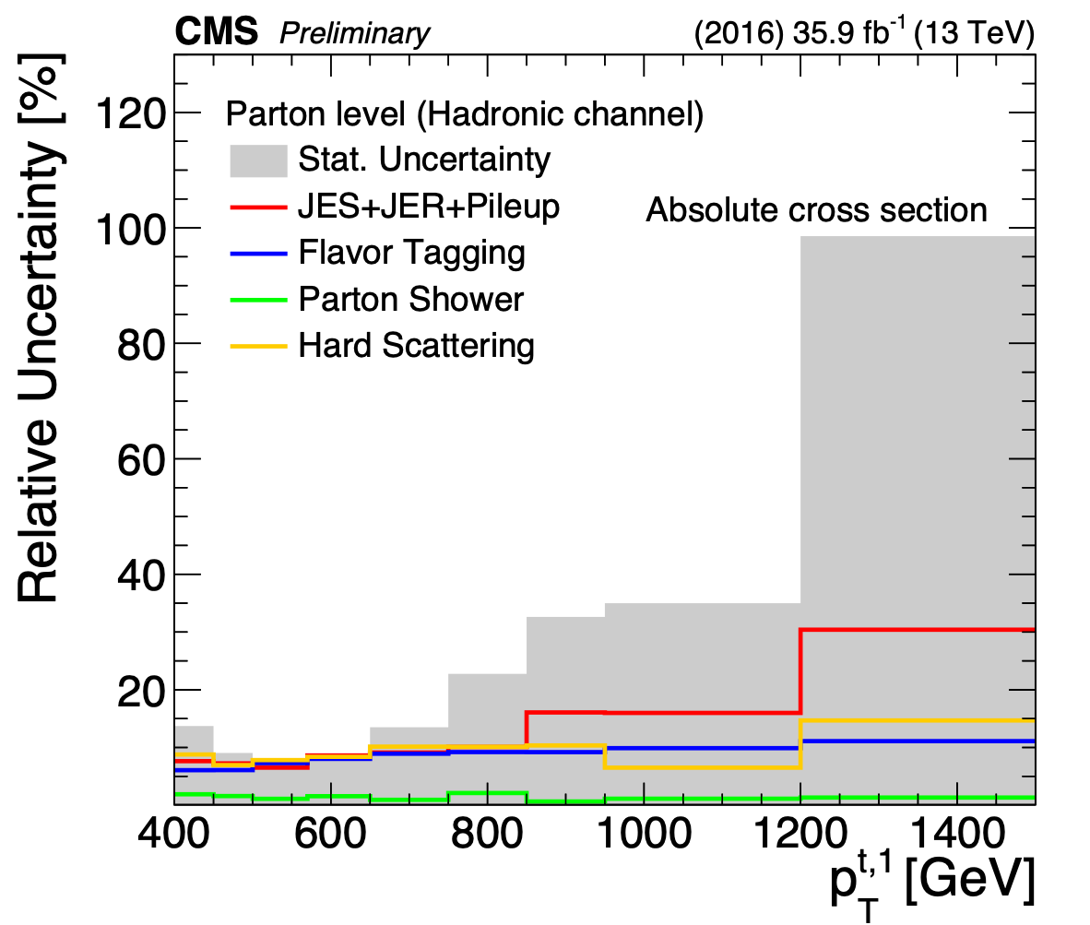
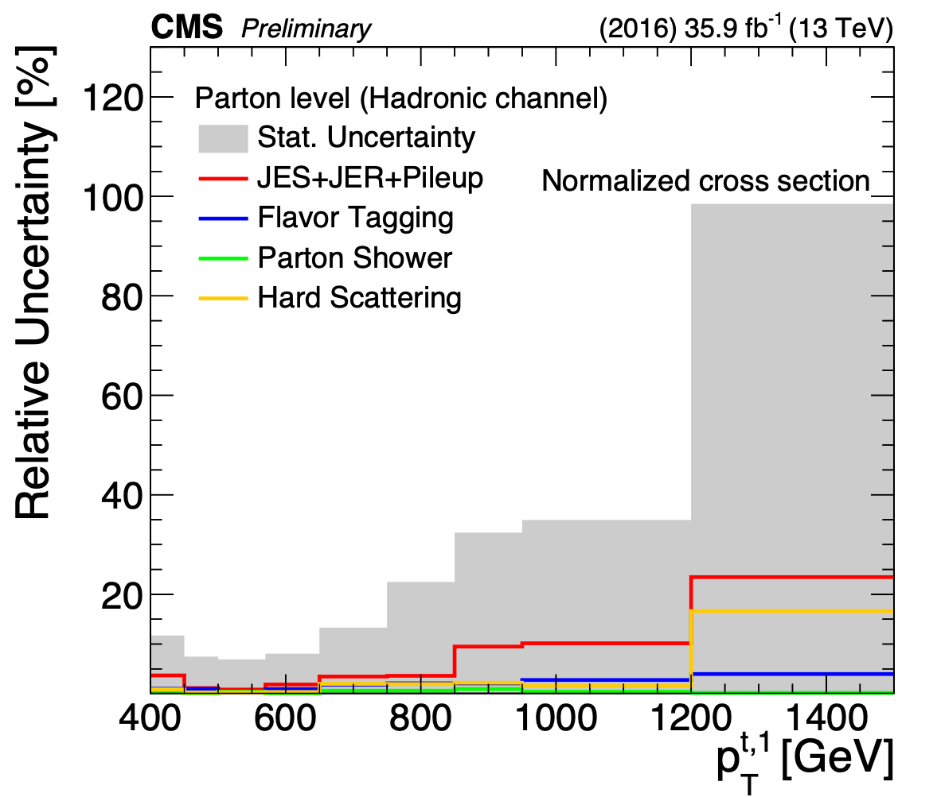
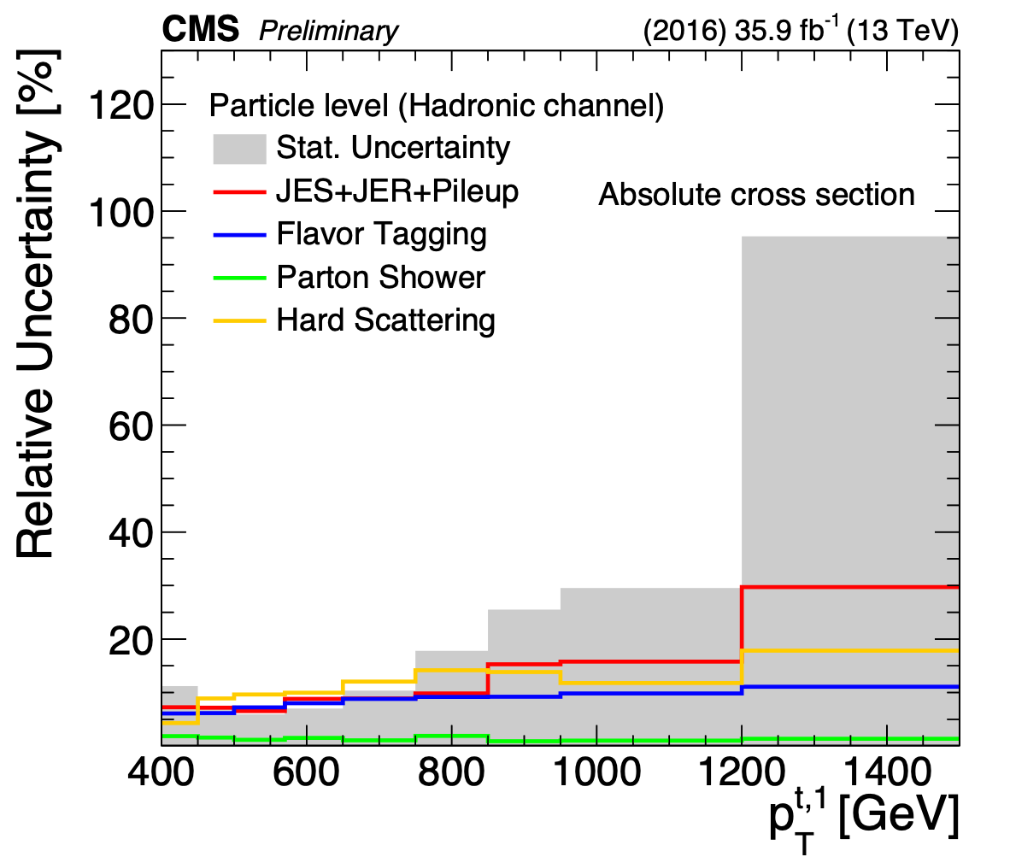
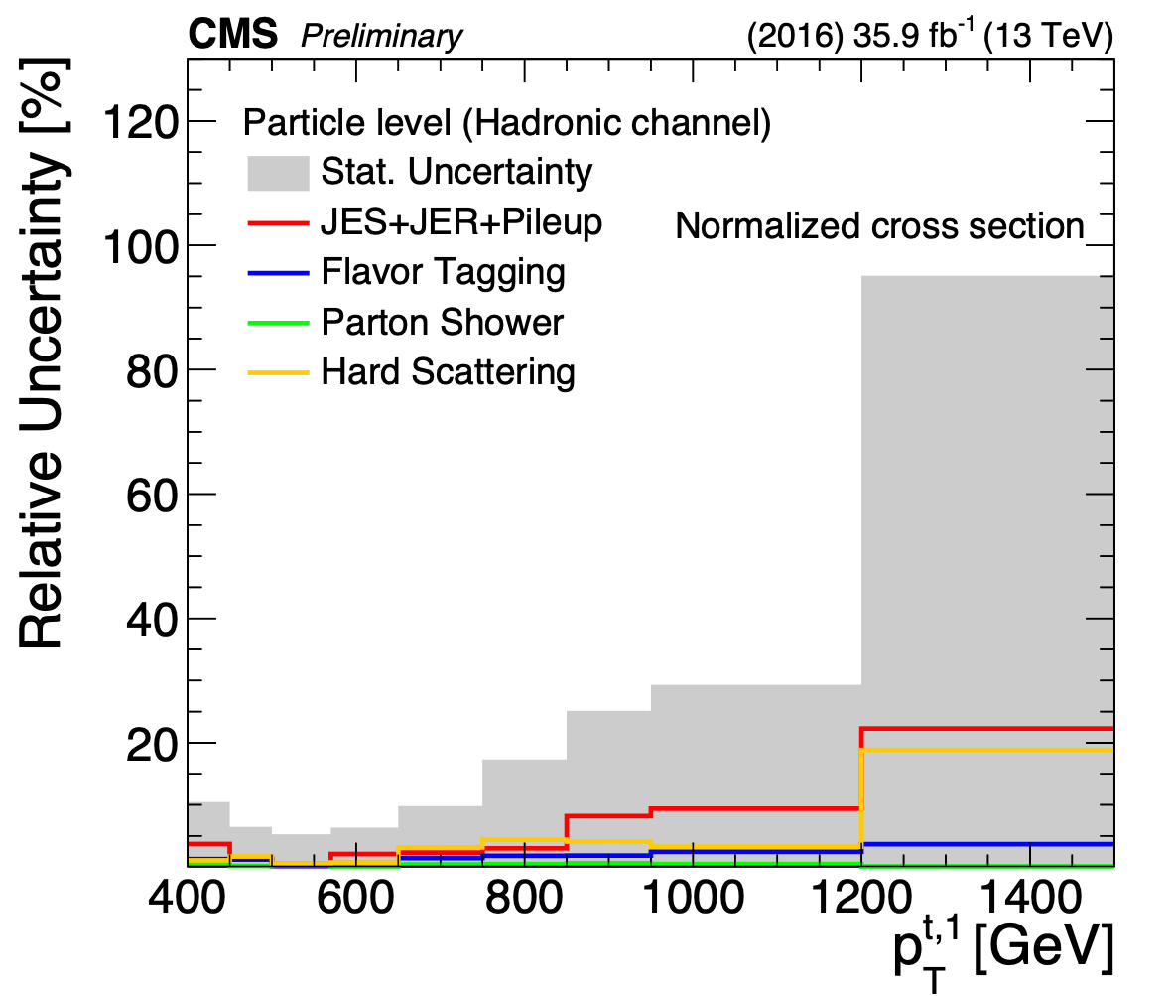
Uncertainties vs leading top pT (hadronic)
Largest Systematic Uncertainty: JES

Slide 18
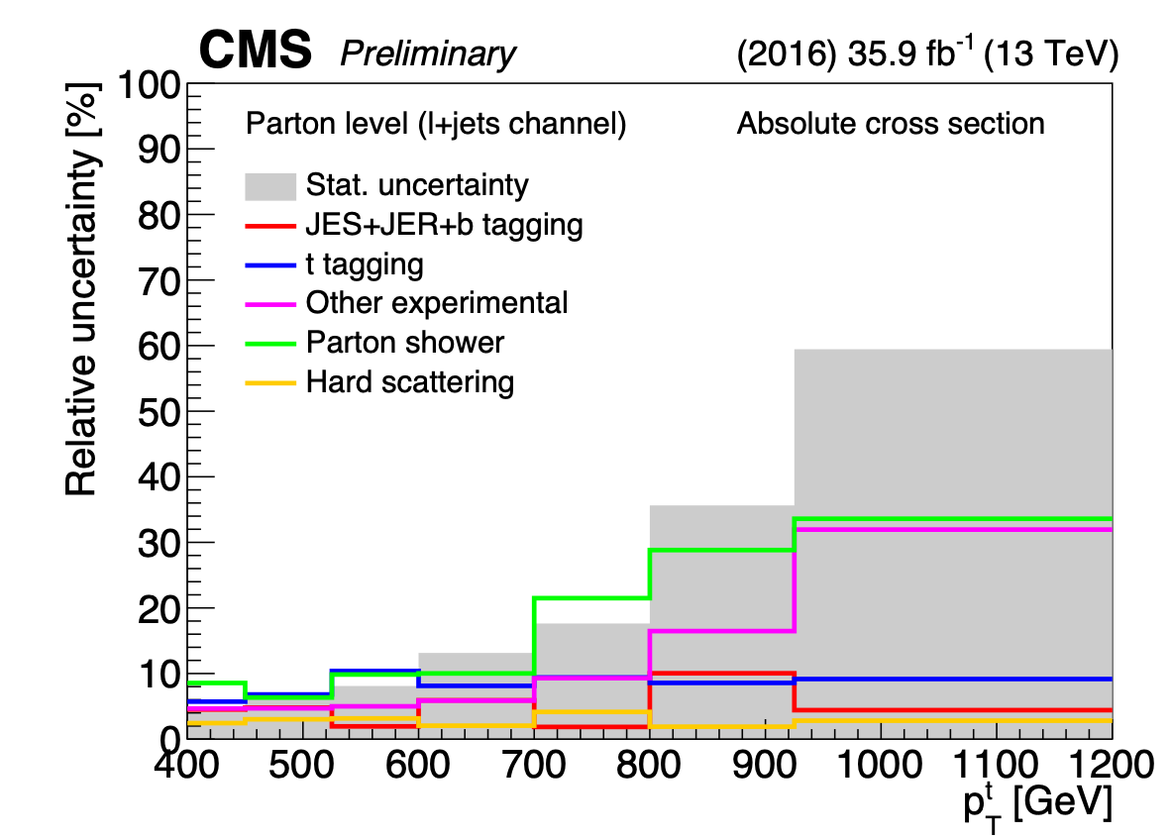
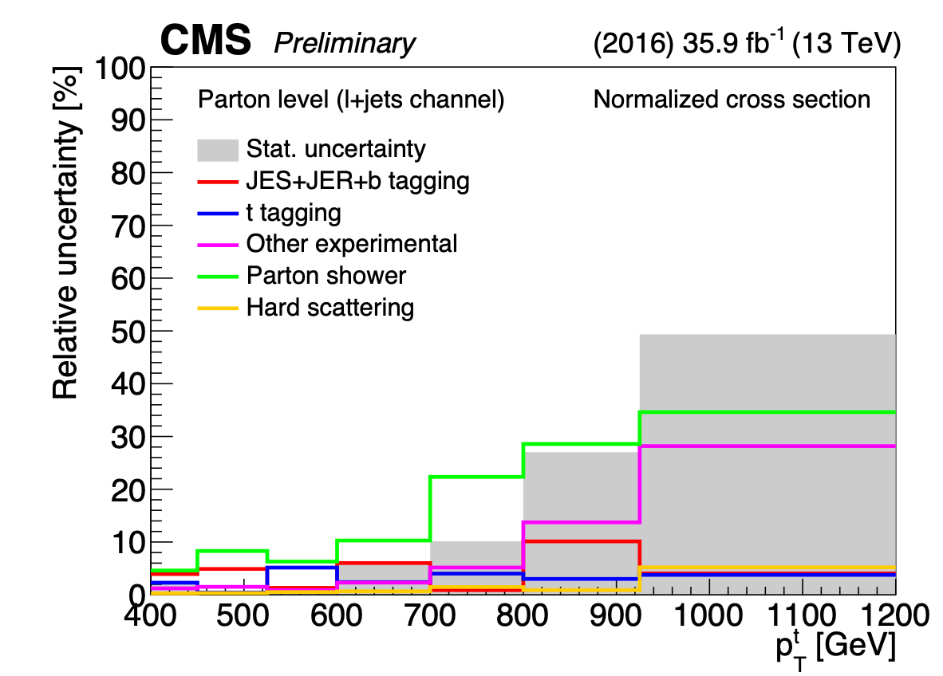
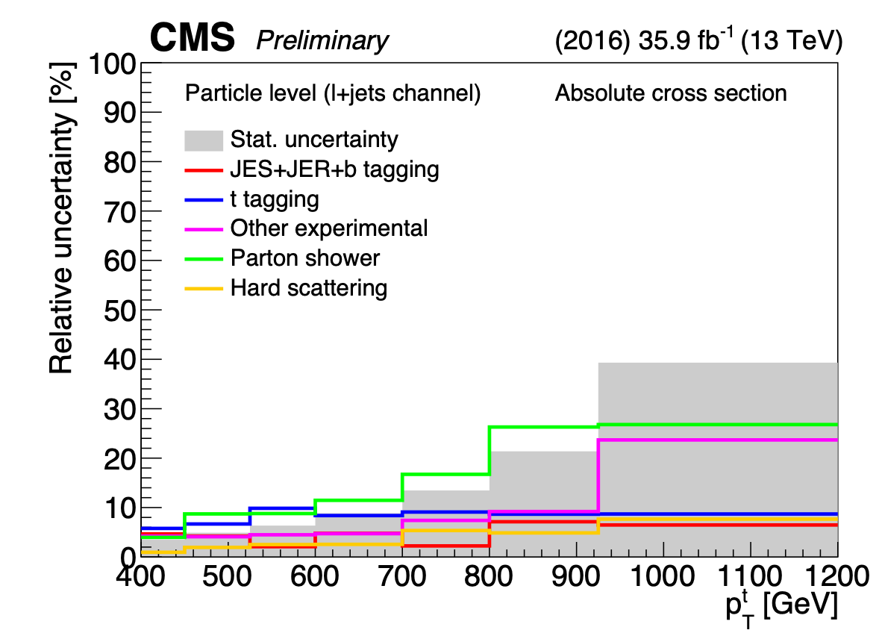
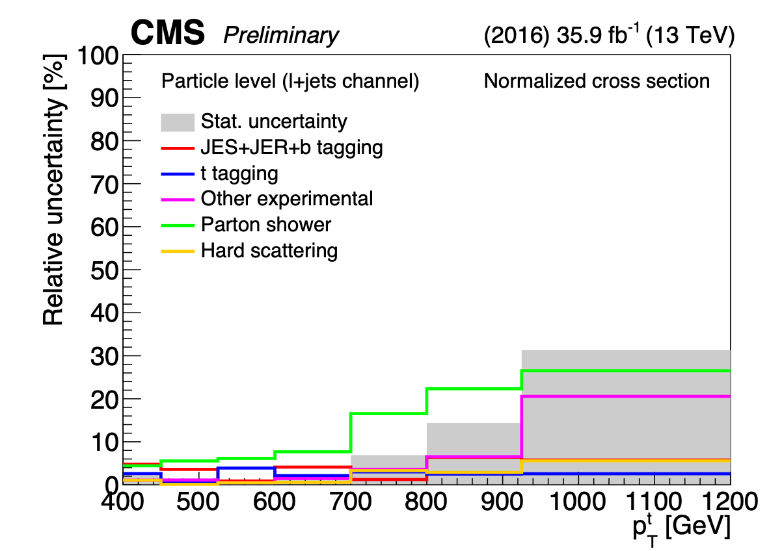
Uncertainties vs hadronically decaying top pT (l+jets)
Largest Systematic Uncertainty: Parton Shower

Slide 19
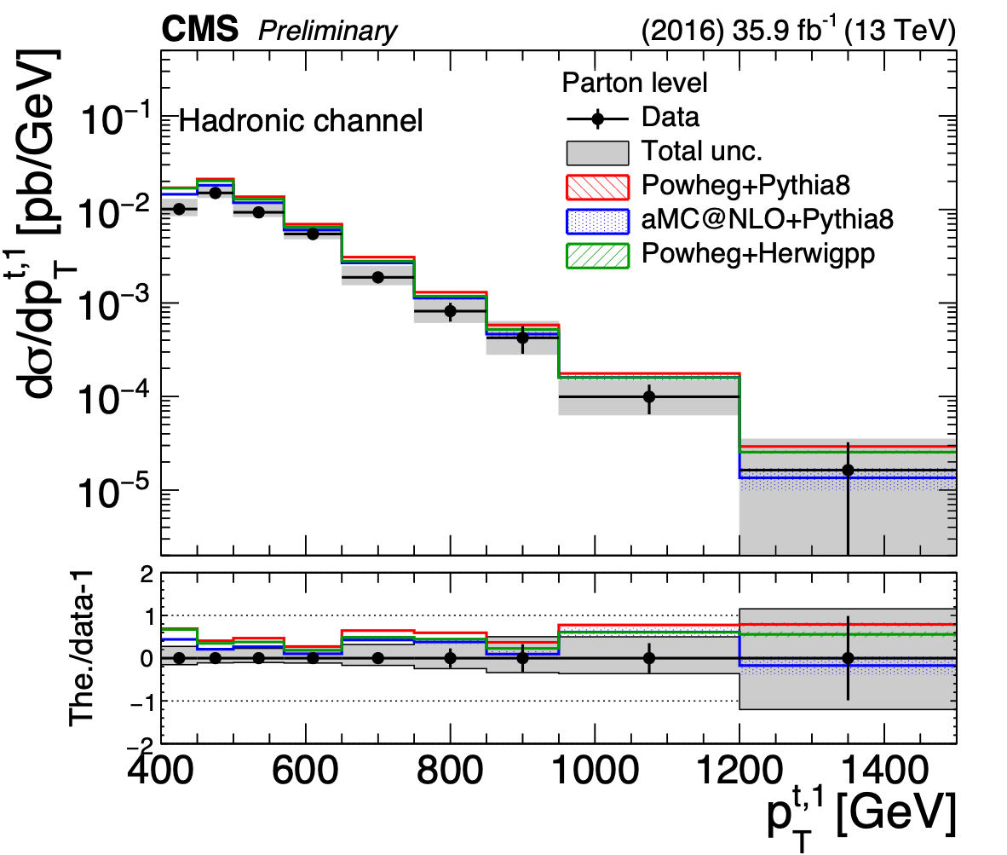
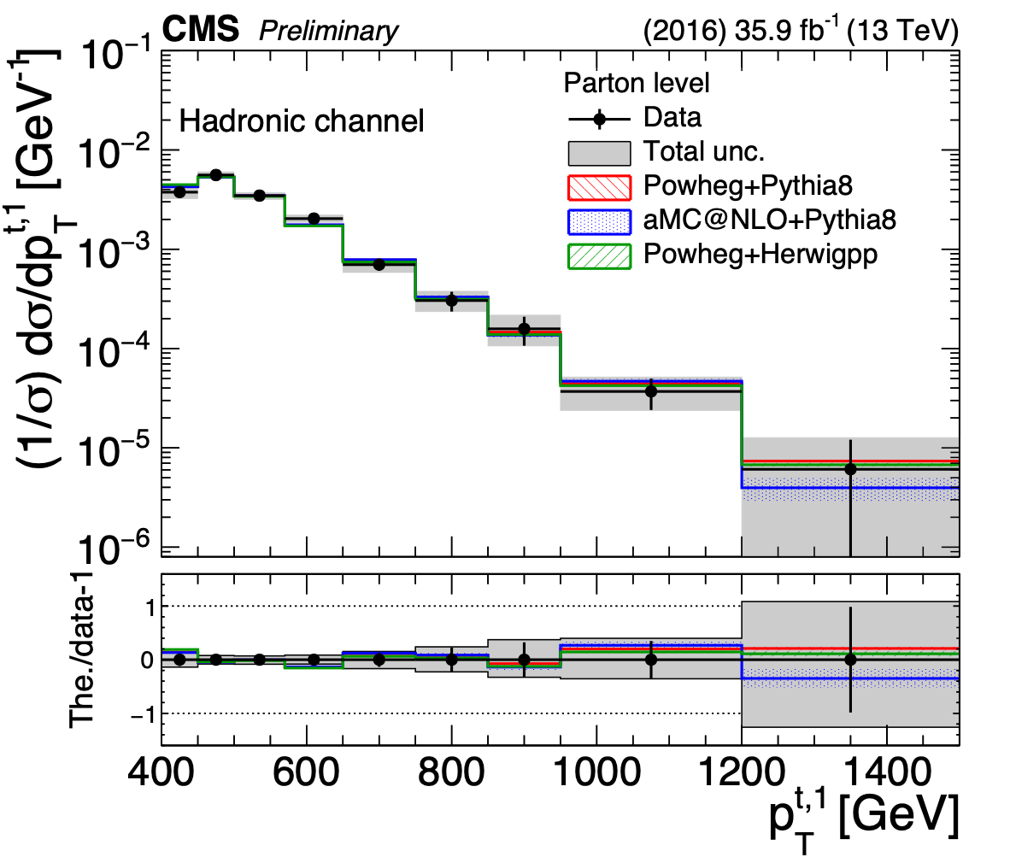
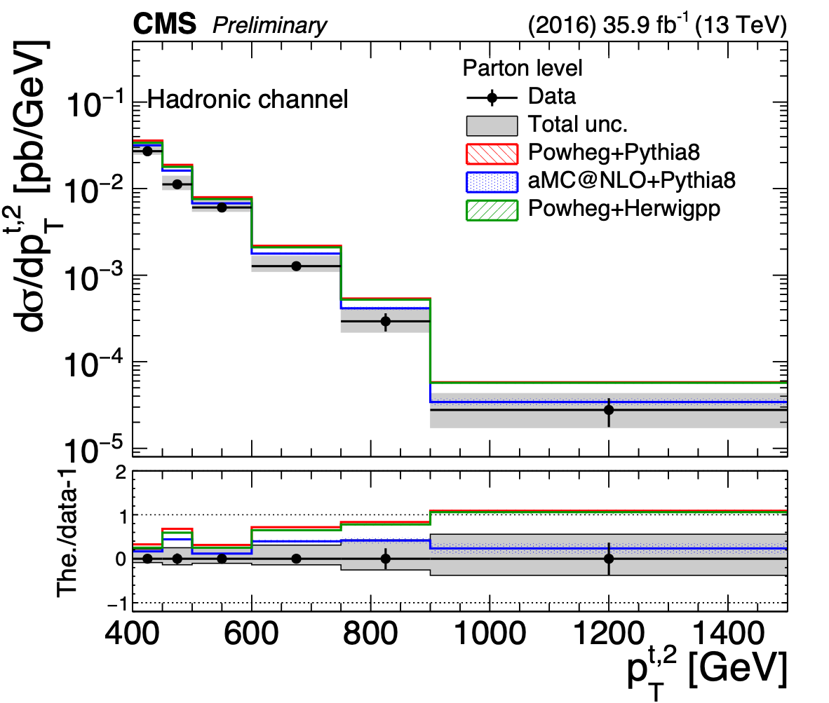
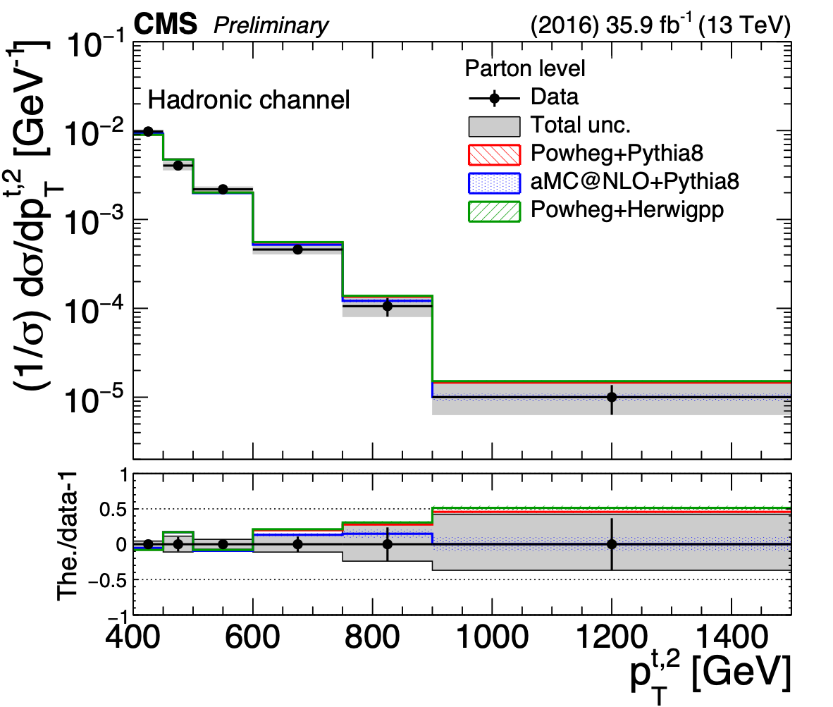
Results (parton, top pT) (hadronic)
Absolute
Normalized

Slide 20
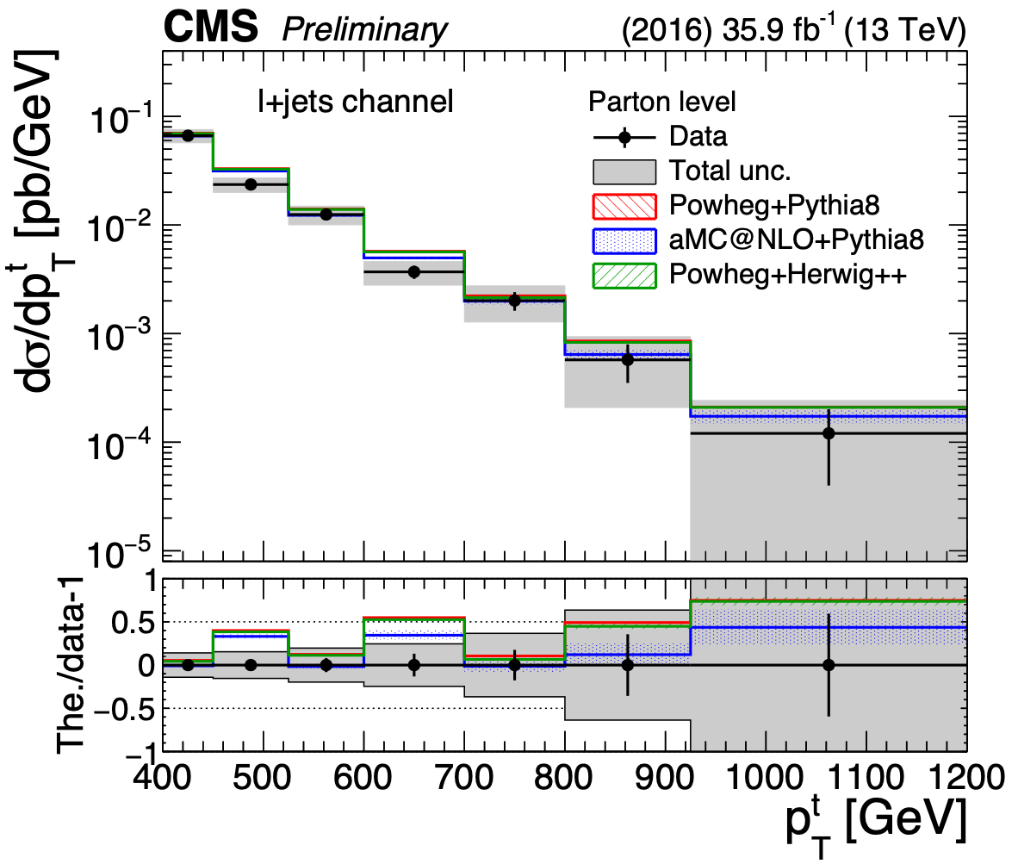
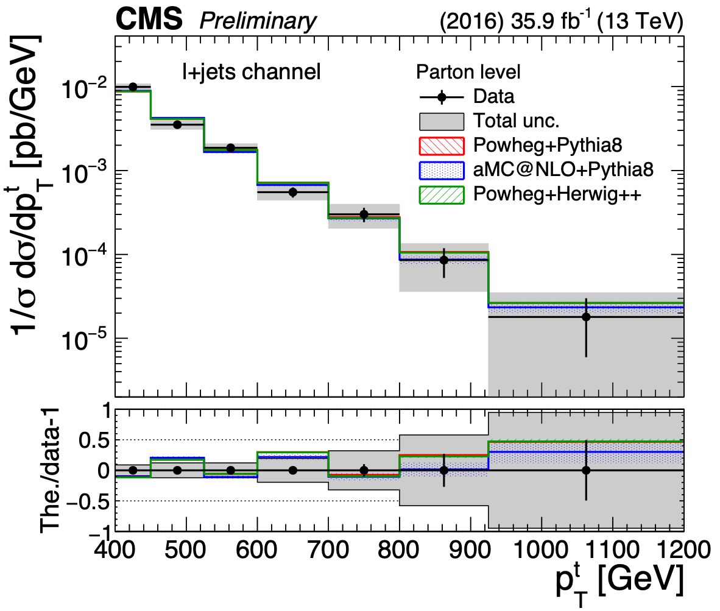
Results (parton, top pT) (l+jets)
Absolute
Normalized

Slide 21




Results (particle, top pT) (hadronic)
Absolute
Normalized

Slide 22


Results (particle, top pT) (l+jets)
Absolute
Normalized

Slide 23




Results (parton, top |y|) (hadronic)
Absolute
Normalized

Slide 24


Results (parton, top |y|) (l+jets)
Absolute
Normalized

Slide 25




Results (particle, top |y|) (hadronic)
Absolute
Normalized

Slide 26


Results (particle, top |y|) (l+jets)
Absolute
Normalized

Slide 27






Results (parton, ttbar kinematic) (hadronic)
Absolute
Normalized

Slide 28






Results (particle, ttbar kinematic) (hadronic)
Absolute
Normalized

Slide 29
Summary
Differential ttbar cross sections with boosted top quarks are presented in hadronic and l + jets channels using 36fb⁻¹ of 13 TeV data
Observables: leading & subleading top pT & |y|,$t\overline{t}$ system mass, pT, y (hadronic channel) and pT and |y| for the hadronically decaying top quark (l+jets)
Parton & particle level
Absolute & normalised cross sections
Results
Comparison with MC models: Powheg+Pythia8, Powheg+Herwig++, aMC@NLO+Pythia8
Hadronic:
Shapes overall compatible with theory: no top pT slope
Overall shift of the order of 35% in the total cross section (Powheg+Pythia8 shows the largest discrepancy)
L + jets:
Differential distributions generally well described
All models overpredict the absolute cross section (~20%)

Slide 30
Backup

Slide 31



Top kinematic distributions (hadronic)

Slide 32




Migration matrices (hadronic)

Slide 33




Migration matrices (l + jets)

Slide 34




Uncertainties vs leading top |y| (hadronic)

Slide 35




Uncertainties vs hadronically decaying top |y| (l+jets)

Slide 36
Selection & Kinematic Regions (l+jets)
Lepton selection:
1 μ(e) passing Medium (Tight) ID
pT > 50 GeV, |η|<2.1, miniIso* < 0.1
Veto additional leptons
In e channel, require$|Δφ(e/j,E_{T}^{Miss})-1.5|<1.5*\frac{E_{T}^{Miss}}{100GeV}$ for e or leading jet
≥ 1b jet candidate:
AK4 jet with pT > 50 GeV and |η| < 2.4
0.3 < ΔR(l, jet) < π/2
≥ 1t jet candidate:
AK8 jet with pT > 400 GeV and |η| < 2.4
ΔR(l, jet) > π/2
$E_{T}^{Miss}$ > 35 (50) GeV for μ (e) channel

Slide 37
Correction Factors (l+jets)
PU reweighting
Lepton Efficiencies:
Trigger — custom T&P in dileptonic boosted tt sample
ID — μ from POG; e from SUS PAG
Isolation — μ assessed to be ~ 1; e from SUS PAG
Jet Energy Corrections
Summer16_23Sep2016v3
Jet Energy Resolution
b tagging SF
t tagging SF
Correlated with Cross Section, extracted from Simultaneous Fit
Standard POG-approved values used

Slide 38



Fit results and PostFit event counts (l + jets)
Posterior t tag | 1.04 ± 0.06
Posterior t mistag | 0.79 ± 0.06

Slide 39
Systematic Uncertainties in Fit (l+jets)
Experimental
Correction factor uncertainties provided by respective POGs
Lepton ID, iso, trigger SFs, JEC, JER, b tag SF
Uncertainties to be constrained by fit given a priori values
t tag SF: 25% uncertainty (separate SF for t tag and t mistag)
Background normalisations: 50% for QCD, 30% for other backgrounds
Separate normalisations for e and μ channel in QCD
Separate normalisations for W+light and W+heavy flavour
Lumi, pileup uncertainties are not included in the fit
Theoretical Uncertainties
PDF: standard deviation of 100 NNPDF3.0 MC replicas
Renormalization and factorization scales (μR/μF): envelope or separately scaling μR, μF by 0.5, 2.0
Initial and Final State Radiation (ISR, FSR): αs for ISR (FSR) varied by a factor of $2\sqrt{2}$
Matrix element to parton shower (ME-PS) matching: resumption damping factor hdamp varied by ±1σ
Color reconnection: variant sample generated with color reconnection model applied
Underlying event: tune CUETP8M2T4 parameters varied by ±1σ

